Slide 1
The Rise of Run-Commuting in the UK
Simon Cook
Birmingham City University & Royal Holloway, University of London

Slide 2
The Project
Run-Commuting in the UK: the emergence, production and potential of a mobile practice
PhD project in Department of Geography, Royal Holloway University of London
5 years – eking towards the end

Slide 3
Defining run-commuting

Slide 4
What is run-commuting?
No consensus about the term for the practice
Run-commuting
Running to work
Run to work
Commuter running
Home running
Turnschuhpendler
Run-commuting as an umbrella term.
A practice in which people choose to run all or part of the way from home to work and/or vice-versa.

Slide 5
Choice and run-commuting
Element of choice is crucial to understanding contemporary run-commuting in the UK.
Running has always been a mode of transport
Unlike historical instances, run-commuting is a mobility of choice rather than necessity.
Choice also helps to differentiate it from other forms of running as transport.
Involuntary in less developed countries
Emergency running as transport
These are not included

Slide 6
Contemporary run-commuting

Slide 7
Run-commuting is not new
Run-commuting is not a wholly new practice
Before sponsorship, many professional athletes would run to work
Run-commuting is changing however.
New sense of enthusiasm
Increasing attention to the practice

Slide 8
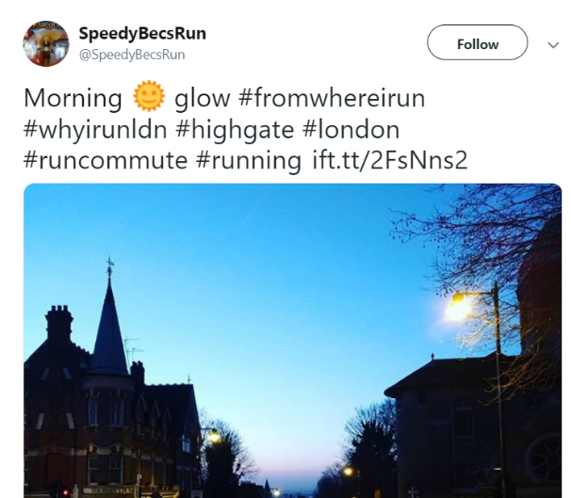
Increasing popularity

Slide 9
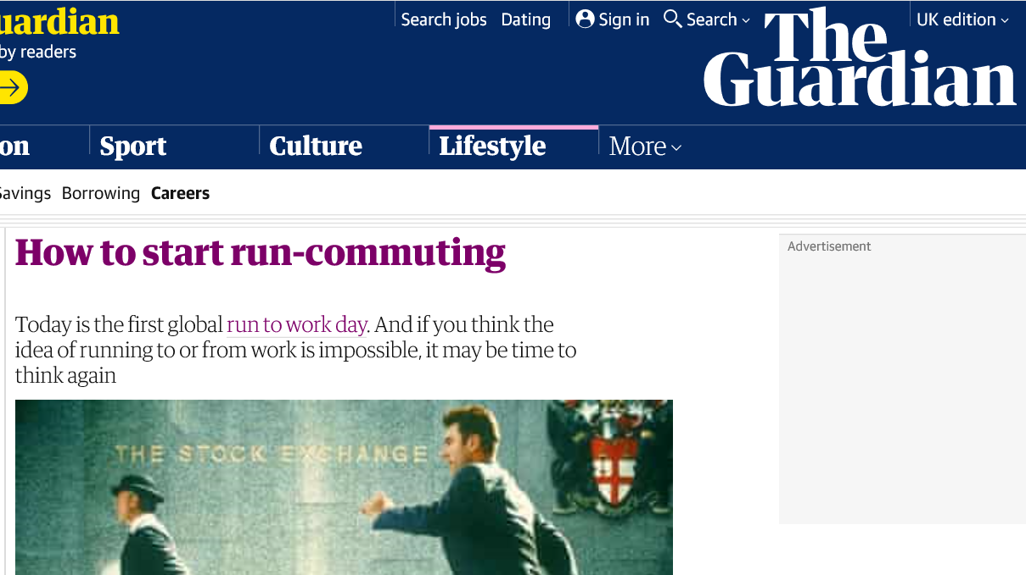
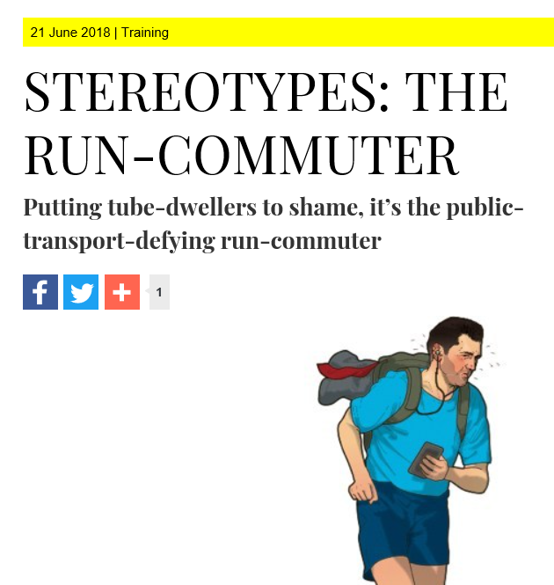
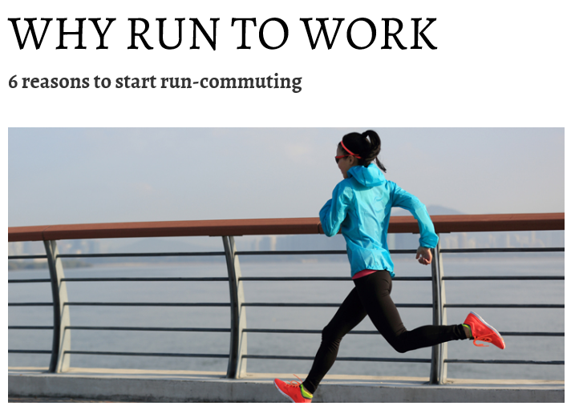
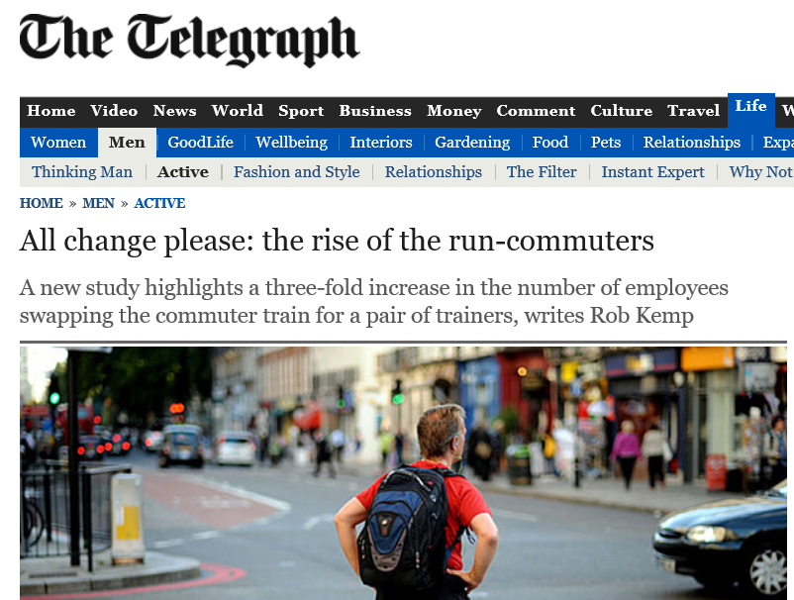
Increasing media interest over last five years

Slide 10
Institutionalisation of run-commuting
Grassroot organisations supporting run-commuting established
Campaigns about run-commuting
Short term challenges

Slide 11
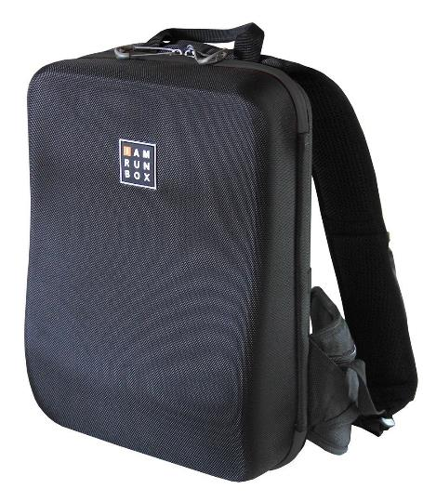
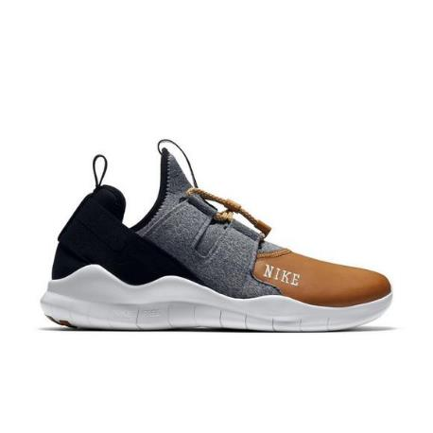
Commercialisation of run-commuting
Now a specific run-commuting market to advertise to.
Involvement in promoting run-commuting
Pitching products specifically to run-commuters
Running backpacks in particular
Many media articles about the best kit

Slide 12
Establishment of run-commuting schemes
Financial clout of commercial organisations have helped to initiative wider run-commuting schemes.
However, this support is often time-limited. Suggests a weak market?
Independent schemes have had greater longevity.

Slide 13
Contemporary run-commuting
Emergent nature of run-commuting is reaching something of a critical mass - sustain it as more than just a mobile fad.
Not just isolated individuals – community has developed.
Institutionalisation, commercialisation and promotion of run-commuting demonstrates that organisations are beginning to design for, market to and ultimately provide for run-commuting.
The idea that run-commuting can become more than just a marginal mode of mobility is starting to gain much purchase
Questions our understandings of running and commuting
Increasingly being discussed within conversations about active commuting, transport provision, public health, workplace cultures and balanced lifestyles

Slide 14
Changing practices

Slide 15
Changing practices
Project speaks more widely to an interest in how practices are changing and specifically how mobile practices change.
Wider changes within running and commuting that are important to situating the rise of run-commuting within.
Productivity
Increase activity
The traditional time-space separation of activities relating to exercise/leisure and commuting is being blurred and challenged.
Increasing possibilities to combine exercise and commuting, which previously occurred within their own specific time-spaces.

Slide 16
What did I do?
Methods

Slide 17
Methods
Survey
363 UK run-commuters
287 current run-commuters
34 former run-commuters
42 potential run-commuters
Interviews
10 organisations
18 run-commuters
8 go-along interviews
10 ‘ordinary’ interviews
Autoethnography (cut short)
Analysis of media material
Ongoing ethnographic engagement

Slide 18
Three most common questions:
How many? Where? Who?

Slide 19
How many people run-commute in the UK?
No idea.
The datasets do not exist but can tentatively use some proxies to estimate:
425,000
241,000
202,000
Strava
upper estimate
Strava
midway estimate
2011 Census estimate
57,000
Strava
lower estimate

Slide 20
Geography of run-commuting in the UK
Home locations
Work locations

Slide 21
Geography of run-commuting in London
Home locations
Work locations

Slide 22
Who are run-commuters? Gender

Slide 23
Who are run-commuters? Age

Slide 24
Who are run-commuters? Age by gender

Slide 25
Who are run-commuters? Dependants by gender

Slide 26
Who are run-commuters? Industry Sector

Slide 27
Who are run-commuters? Household income

Slide 28
Who are run-commuters? Education level

Slide 29
Who are run-commuters? Ethnicity

Slide 30
The average UK run-commuter
White
Male
Middle Age
Middle / Upper income
Highly educated
Able bodied
Works in education or finance
There is a lot of privilege involved with run-commuting.
It is a very gendered, bodied, classed and racialised practice.

Slide 31
Questions?
Simon Cook
Birmingham City University & Royal Holloway University of London
Simon.Cook@bcu.ac.uk
@SimonIanCook
Thank you

