Slide 1
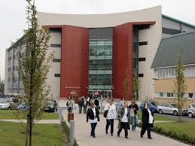
Active commuting and cardiometabolic outcomes
Abolanle Gbadamosi
School of Health and Society, University of Salford, UK

Slide 2
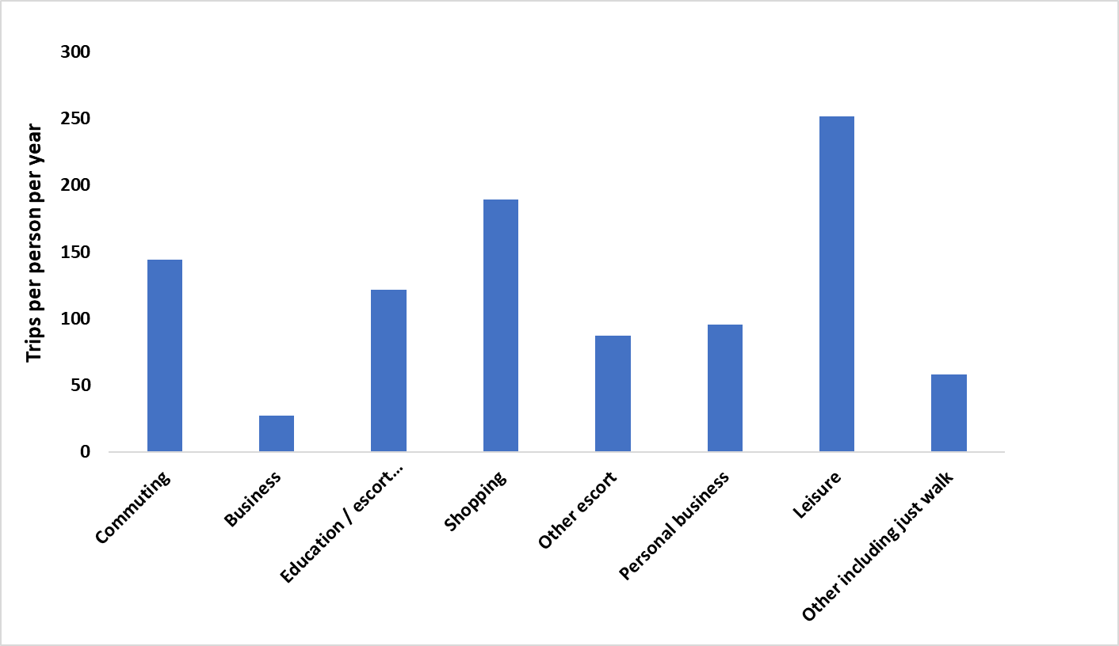
Reasons why people travel
1 out of the top 3 reasons
15% of trips per person
20% of distances travelled
Source: UK Department for Transport, 2017
Notes:
Commuting is a regular, unavoidable activity which absorbs substantial amount of time and resources and may be a dominant of a worker’s life for any years. Therefore, it can either serve as an opportunity to improve health or an hindrance to healthy lifestyles

Slide 3
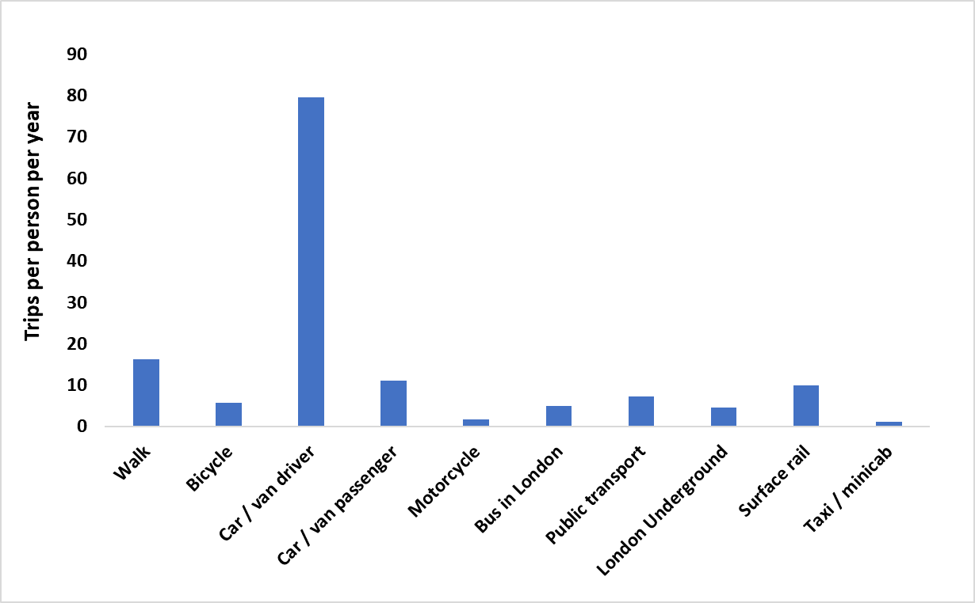
Number of commuting trips per year
Source: UK Department for Transport, 2017

Slide 4
Commuting Statistics
In the UK, 64% by car
11% by walking
7% by Public transport
An average one-way commute takes 31 minutes.
Source: UK Department for Transport, 2017
Notes:
Active commuting has been recognised as a way of Incorporating physical activity into daily life by walking, cycling or combining with the use of public transport instead of travelling by car, thereby meeting recommended guidelines

Slide 5
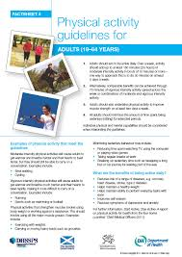
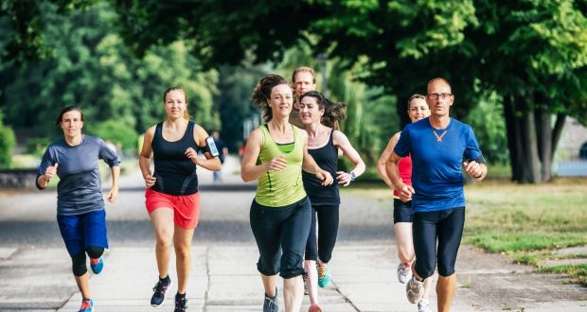
How much physical activity is enough?
150 minutes of moderate intensity (MVPA) per week
30 minutes for 5 days

Slide 6
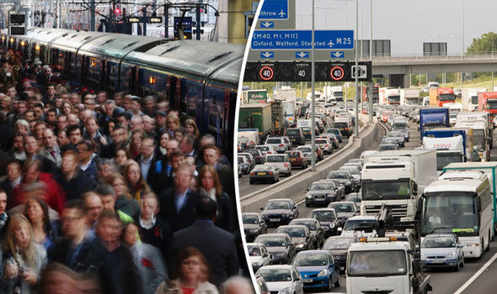
Commuting time in the UK
Average one-way commute time =31 minutes *2
=62 minutes/day * 5
=310 minutes per week
i.e., 48% of average commute time (310 minutes)
=
150 minutes per week (Physical activity guidelines)

Slide 7
Physical activity is good for you!
Notes:
Including mental health and physical health. BUT the challenge is changing health-related behaviour

Slide 8
BUT…
Changing health-related behaviour can be challenging
Is active commuting a solution?
‘Active commuting has been recognised as a way of incorporating physical activity into daily life by walking, cycling or combining with the use of public transport instead of travelling by car, thereby meeting recommended guidelines’ (NICE, 2012)
Notes:
-39% of the population do not still meet up with physical activity guidelines.
-64% of the working population travel by car.
-Lack of physical activity costs the NHS more than 450 million a year
-physical inactivity is the fourth most important risk factor responsible for NCDs.
-Advancing technologies and increasing car use are some of the factors that are responsible for low levels of physical activity
*Active commuting involves any walking or cycling undertaken during commuting; which includes public transport

Slide 9
SOME KEY FINDINGS FROM PhD PILOT STUDY ON CONTRIBUTION OF COMMUTING TO PHYSICAL ACTIVITY

Slide 10
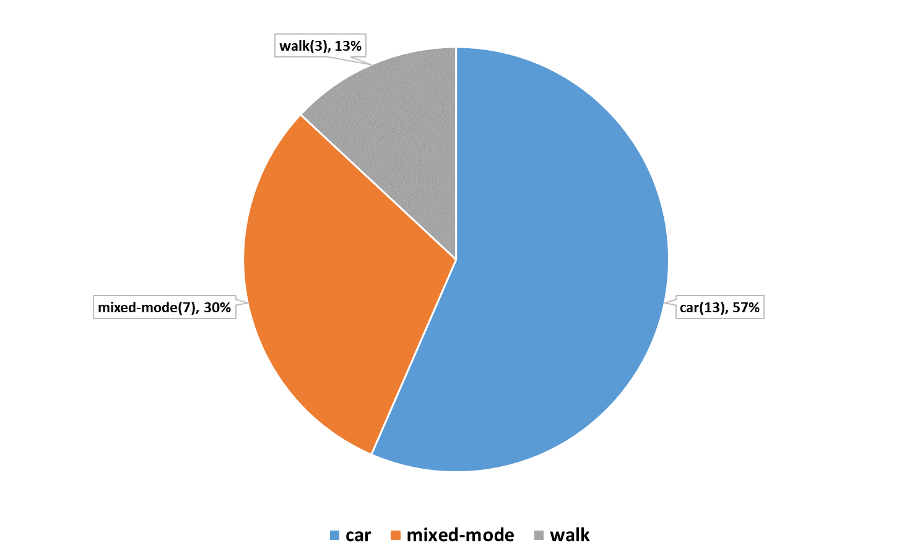
Mode of commute
23 participants
13 commute by car,
7 by mixed-mode, and
3 by walking

Slide 11
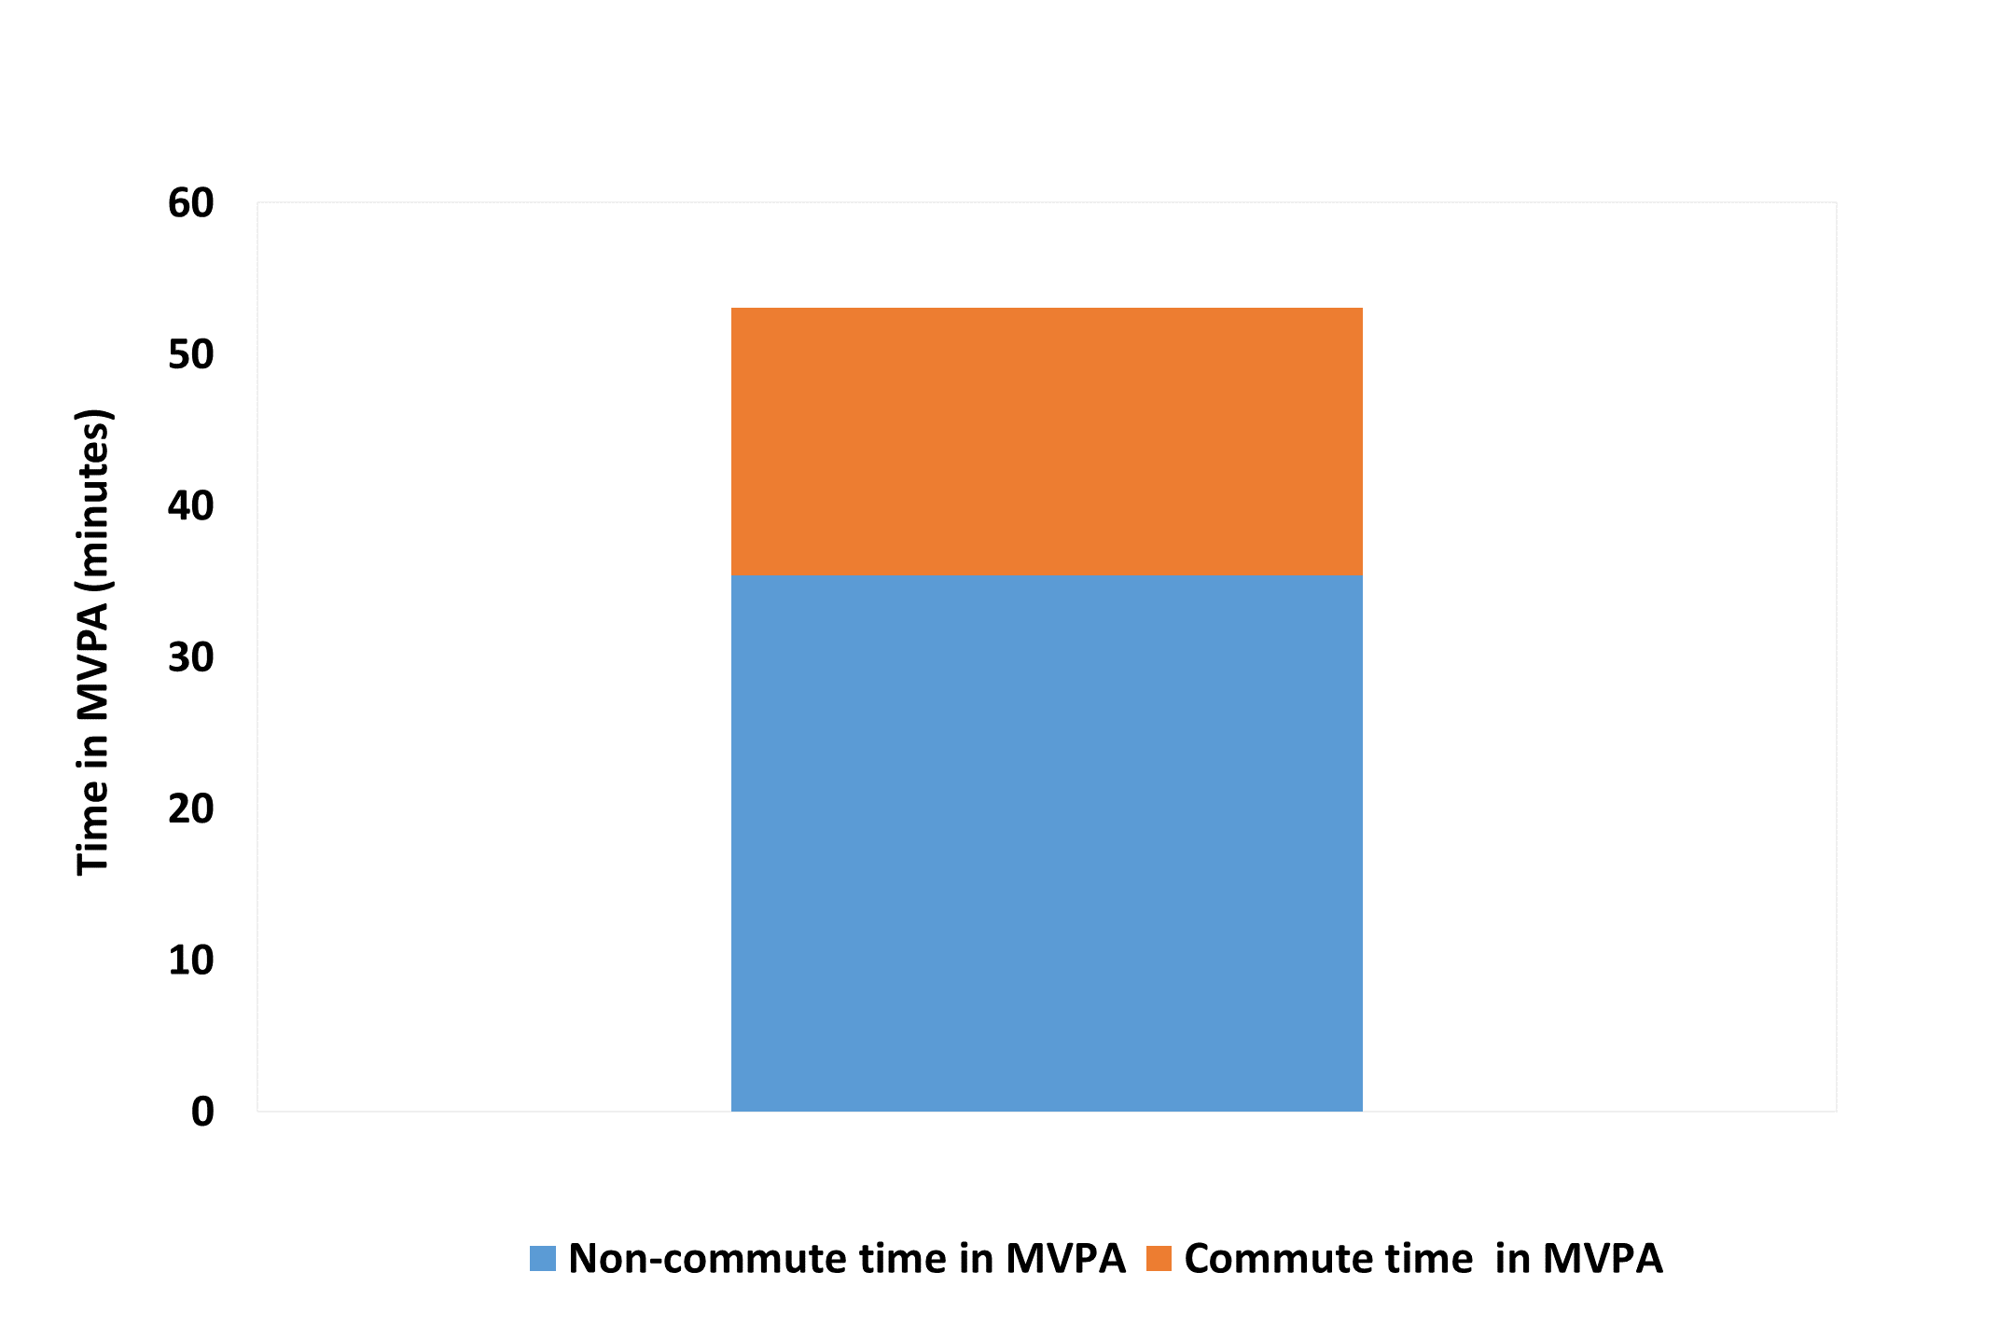
Time in MVPA
33% of total time in MVPA was during commute (17.1 minutes)
An average of 65.4 minutes was spent commuting each day
Notes:
Total time spent in mvpa was 53.1 mins and 17.1 mins which is 33% of total time was during commuting.
An average of over an hour is spent in commute per day

Slide 12
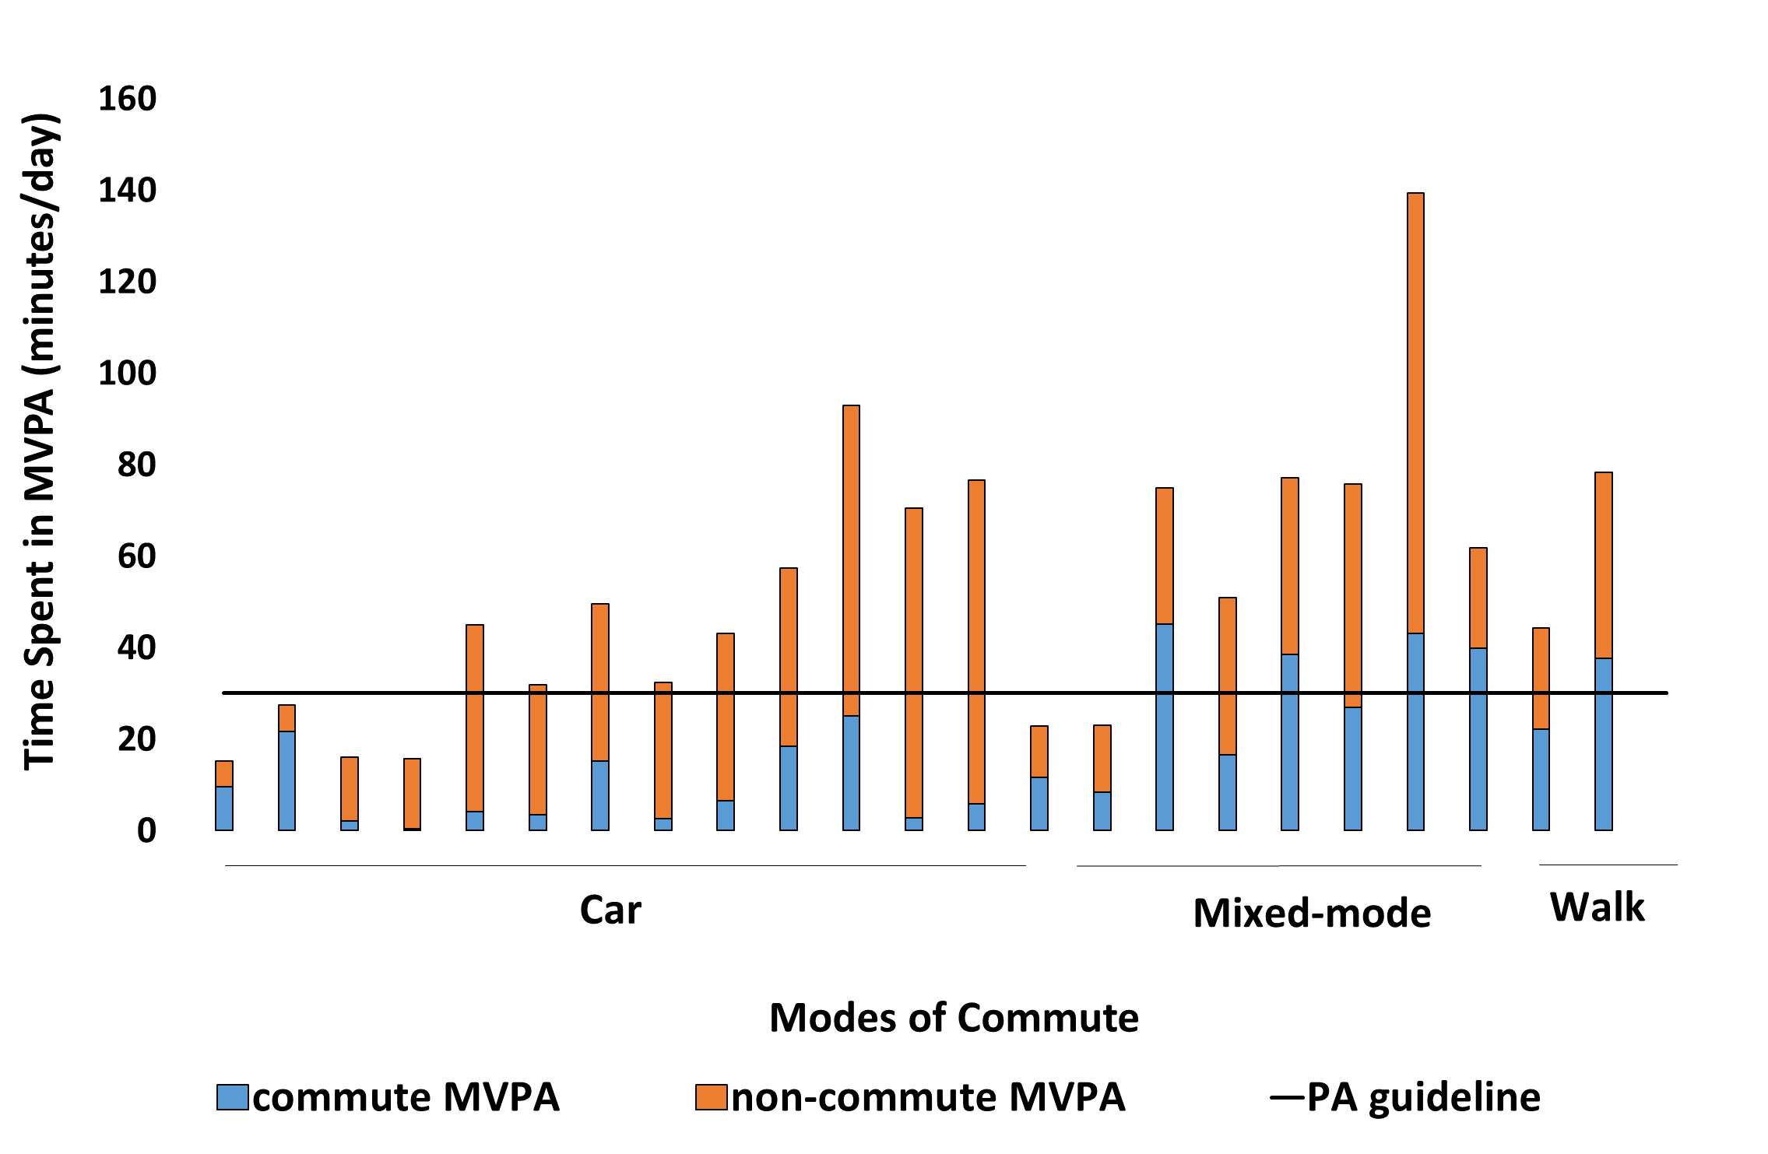
Time in MVPA for all commute modes
5 commuters met the guidelines in their commute alone (irrespective of bout lengths)
Notes:
However, when we look at compliance level irrespective of stepping bout lengths, then we see more participants being compliant and even 5 participant meeting pa guidelines in their commute.
Further analysis to investigate the impact of physical activity accumulated during commuting and cardiometabolic risk factors as most commuting studies have focused on the mortality outcomes.

Slide 13
Why active commuting?
Reduces BMI
Active commuting
Increase in physical activity
Reduces risk of heart diseases

Slide 14
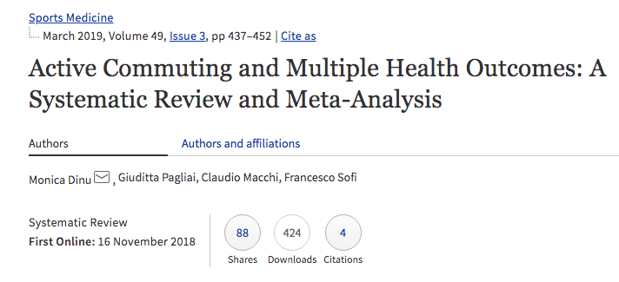
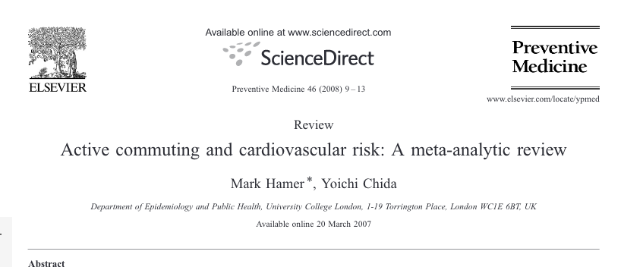
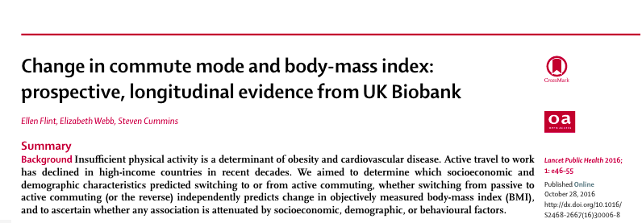
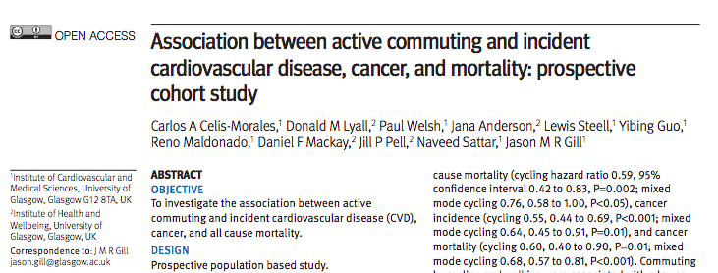

Slide 15
Aim of the study
To use a large prospective based cohort study, UK Biobank to investigate the association between different types of active commuting and incident cardiovascular diseases, cancer, and all-cause mortality

Slide 16
Case study’s population
263,450 UK Biobank participants
Aged between 37 to 73 years
Employed and did not usually work from home
54% were women
Modes of commute were classed as:
Non-active (reference group)
Walking’
Cycling
Mixed mode: cycling
Mixed mode: walking

Slide 17
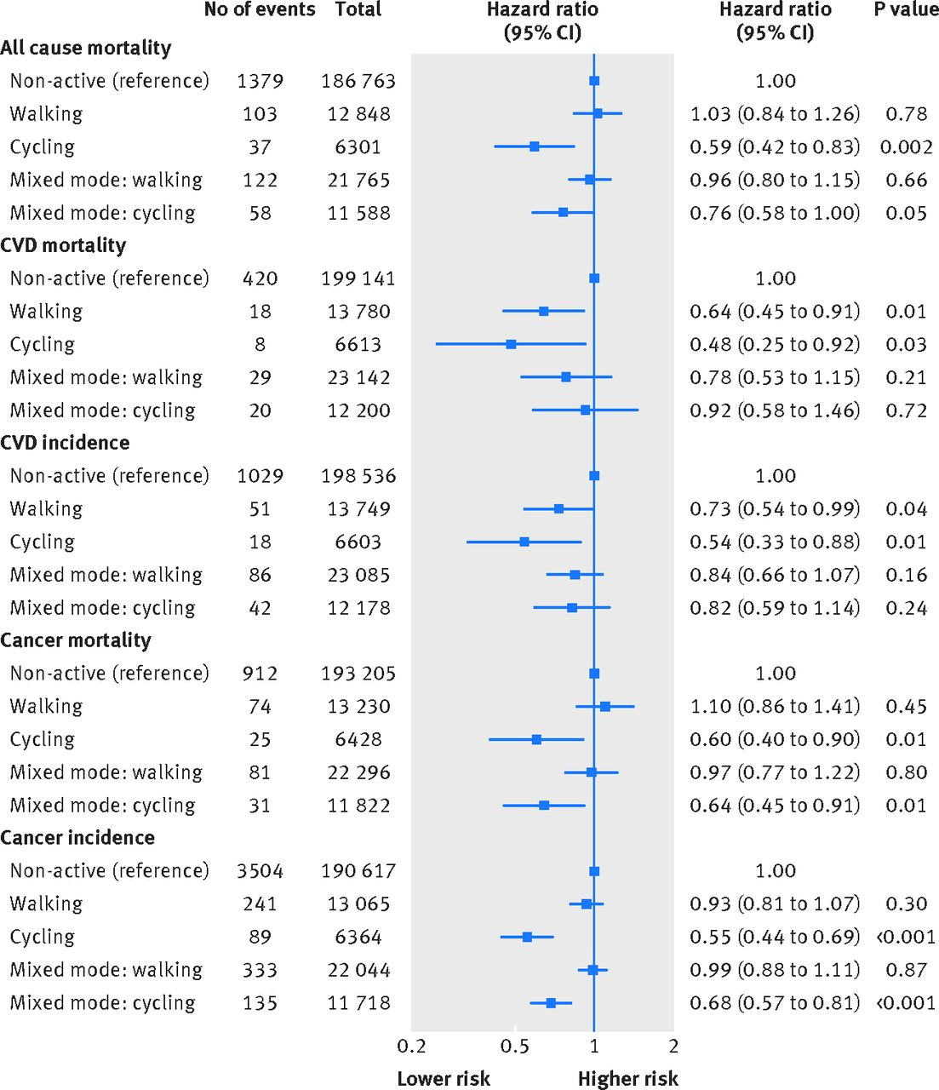
Walk Cycle Mixed mode:cycle
NS 41% 24%
36% 52% NS
27% 46% NS
NS 40% 36%
NS 45% 32%
NS= Not Significant
Notes:
Main findings:
-Cycling to work had a 41% reduced risk on premature dying compared to the non-active commuters

Slide 18
Key Findings from Case study
Cycling or walking to work reduced your risk of heart disease
Cycling to work will also reduce your risk of premature death and cancer mortality
Brisk walking can reduce risk of premature deaths, heart disease and cancer.

Slide 19
Barriers to the uptake of active commuting
Travel distance from home to work
Unpredictable or bad weather
Ineffective transportation system and infrastructure
Convenience
Notes:
-Main contributor to barriers are duration of time spent commuting
-Lengthy commute time results in use of non-active modes of commute and therefore, contributes to increased levels of stress and time that coukd have been spent in physical activities.

Slide 20
Conclusion
Commuting can provide significant contributions to total MVPA.
Mode of commuting has a very important effect on the level of MVPA accumulated during travel.
Active commuting is an important way of improving physical activity and in therefore in improving the health of the populations.
Notes:
Commuting to work contributes to total physical activity and the mode of commute plays a role in the amount of physical activity accumulated

Slide 21
Implications
Encouraging sustainable and active travel will result in healthier commute journeys via walking, cycling, or public transport.
Fewer car journeys would lead to fewer crashes as most crashes are as a result of the driver’s error.
Incorporating physical activity into everyday activities is as effective for weight loss as supervised exercise programmes.
Encouraging sustainable and active travel can promote eco-friendliness of the environment. For example, the cleanAir initiative.
DH, 2011; www.brake.org.uk
Notes:
Encouraging and enabling increased sustainable and active travel benefits people’s health, personal finances, the environment, and the economy.

Slide 22
www.health.org.uk/healthy-lives-infographics
Notes:
Read highlighted box

Slide 24
Thank you for listening. Any questions?
Notes:
Stress levels? Mental health?
Does commuting increase or reduce productivity?

