Slide 1

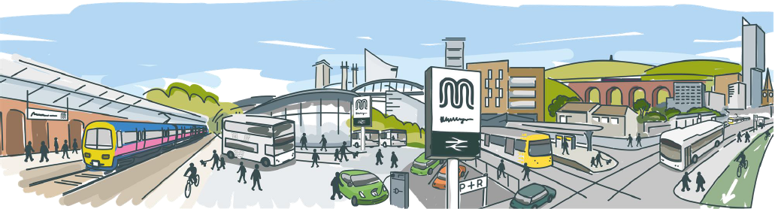
Impact of big data on mobility
Conor Chaplin
conor.chaplin@tfgm.com

Slide 2






10 authorities working together
2.8 million residents
Economic potential exceeds all other UK city regions
UK’s first Combined Authority
Centre of innovation, education, industry and culture
The heart of the north

Slide 3
A growing future for Greater Manchester
Rapidly increasing population currently at 2.8m with a forecasted 15% increase by 2030
Over 2.1 billion journeys are generated every year - ONLY 268 million of which are made by public transport modes
More than 600,000 additional trips on our transport networks every day by 2030
A third of journeys under 1km journeys are made by car
Congestion costs GM businesses £1.3bn

Slide 4
What we do
Own Metrolink, the largest light-rail network in the UK
Work closely with bus, tram and train operators to improve full-journey experience
Operate major interchanges such as Shudehill, Rochdale and Piccadilly Gardens
Subsidise bus routes that otherwise would not be served by operators and operate Free Bus services in Manchester
Provide more affordable fares to help older people, young people, and those with restricted mobility
Develop easier, smarter ways to travel and plan your journey using data and technology
Notes:
Our Pass – free bus travel for 16-18 year olds launching 1 July
Contactless coming soon to Metrolink with daily capping
Currently working to improve and potentially reform bus services
TfGM currently spends £27.1m a year subsidising ~20% of GM bus services

Slide 5
Our current priorities
Clean Air Plan 2019 – Greater Manchester’s plan to reduce transport-related air pollution
Large scale expansion of GMEV network with dual-headed rapid chargers
Development of bike sharing models
£160m investment in cycling and walking infrastructure across the region with a network of more than 1800 miles
Integrated ticketing on public transport
Future of Mobility trials
Notes:
40000 premature deaths a year in UK due to air pollution (Royal College of Physicians), proportionally adjusted to be 2000 in GM
£160m currently allocated for Bee Network (costed at approx. £1.5b)
Mayoral position to stop spending on roads - £1.4b spent on road junction in Bradford saving appox. 10 minutes for car drivers through the junction

Slide 6

Our vision for 2040
We want 50% of all trips in Greater Manchester to be made by walking, cycling, or public transport by 2040.
That’s a million more sustainable journeys per day.
This will allow us to deliver a healthier, greener and more productive city-region without increasing overall traffic levels.
1 MILLION MORE
SUSTAINABLE
JOURNEYS PER DAY

Slide 7
Innovation at TfGM
R&D
Intelligent Mobility
New Mobility
Connected Infrastructure and Place
Connected and Autonomous Vehicles
AI and Machine Learning
Data and Insights
Smart Cities
Open Innovation
Shared Mobility
Micro-Mobility
On-demand Mobility
First/Last mile connectivity
Mobility as a Service
Future connectivity – 5G
Mobility hubs
GMEV electric charging
Dynamic kerbside management
Virtual / digital mobility infrastructure
Partnership and Collaboration
Future funding – H2020, Innovate UK, Local Industrial Strategy, Future of Mobility Urban Strategy
Internal and external partners – GMCA, Mayor’s office, Department for Transport, Transport Research Laboratory
Cross-sector partnerships in both the UK and Europe
SME Procurement / Demonstration Framework
BaU

Slide 8
Improved access to better data

Slide 9


Slide 10





Cityverve built a smart city demonstrator using trailblazing Internet of Things (IoT) technology through a collective desire for ongoing collaboration.
2km²
£16m
20
1st July 2016
Innovation corridor
IoT investment
delivery partners
Start date

Slide 11





Transport & Travel
Health & Social Care
Energy & Environment
Culture & Public Realm

Slide 12

Transportation & Travel
eBike Sharing – IoT to create next-gen cycle share scheme
Road Safety – In-Car telematics for road safety
City Concierge – Digital Way finding & City Discovery

Slide 13
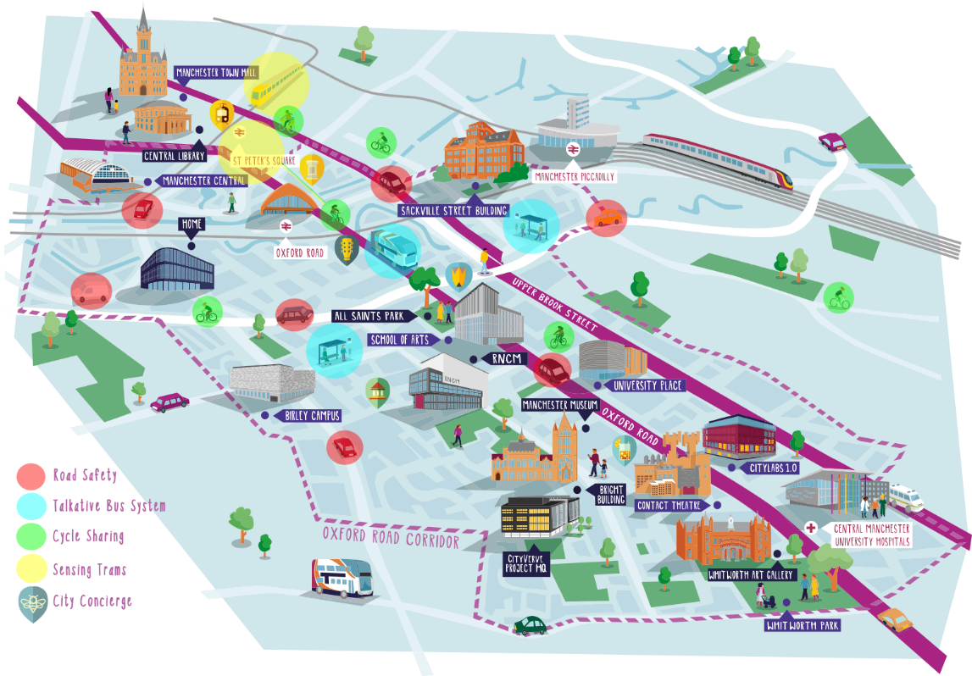
Notes:
Approx. 60,000 workers along the corridor, as well as students, research centers, innovative STEM businesses, NHS trust, large scale infrastructure commitment. Enables a smart city to be demonstrated in a small area, “micro city”.

Slide 14

CitySPIRE
How can we predict and dynamically react to changes in demand?
Use of aggregated data collected through Bluetooth and Wi-Fi
Prediction of demand to aggregate transport into appropriate vehicles and locations
Improvements to accessibility and passenger experience
More sustainable and reduction in congestion
Analysis of mobility allows us to understand passenger needs and potential incentives

Slide 15
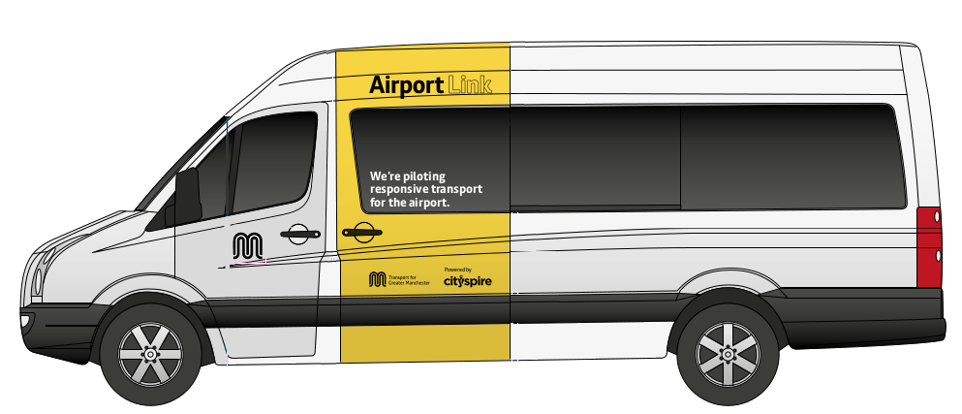

Slide 16
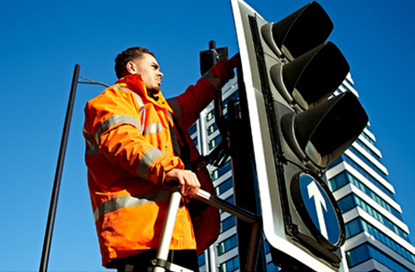
GM Data Hive
Innovate UK funded project to open up SCOOT data
Working with local academics, developers and data scientists
Promote open innovation
Aim to gain a better understanding of what data people want
Development of open data APIs

Slide 17
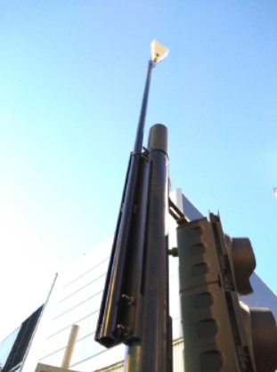
Smart Junctions
Research project working with Vivacity
Use of artificial intelligence and machine learning to dynamically adapt and optimise traffic signals
May offer an improvement on existing SCOOT and MOVA junctions

Slide 18
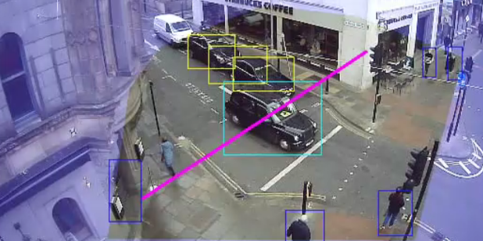
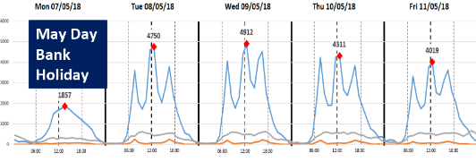
Understanding people and vehicle movement
Research project working with Tracsis
Sensors detects and classifies movements for local processing
Road users and pedestrians can be classified and path-lines generated
System aggregates and anonymises data before extraction
Data can be fed back into machine learning algorithms and used for analysis
Notes:
All data is processed locally on the camera device. No personally identifiable information can be transmitted or extracted and cameras are fully GDPR compliant and comply with current legislation regarding use of CCTV in public spaces.

Slide 19

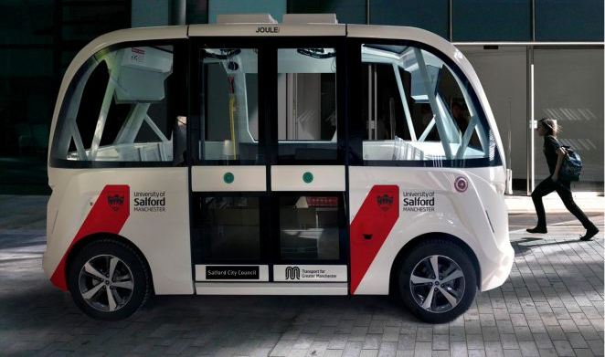
What next?
Department for Transport Urban Mobility Strategy
Accelerate the roll-out of 5G in Greater Manchester and developing use cases
Clean Air Zone
Connected and autonomous vehicles – Project Synergy and University of Salford
Notes:
£112m bus priority package and opening of NW’s first guided busway – reduce car movements in morning peak by 22% to 2006.

Slide 20
Key to success?
Open data.

Slide 21
Thank you
Conor Chaplin
conor.chaplin@tfgm.com

