Slide 1
Using Data for a Smarter Manchester
Adrian Slatcher, Manchester City Council Salford University, 26.06.19.

Slide 2
Why we need to be smart
Urban challenges are large and common across many cities providing opportunities to learn and to scale
20 years ago we were addressing decline - now having to deal with success
Cities are interconnected: health, transport, air quality, housing, employment are all connected
Doing more with less - since 2010 our budgets have reduced by 40% and our staffing by 30%
Citizens expect more: same convenience in public services as from Facebook, Google, Amazon, Uber, AirB&B et al

Slide 3
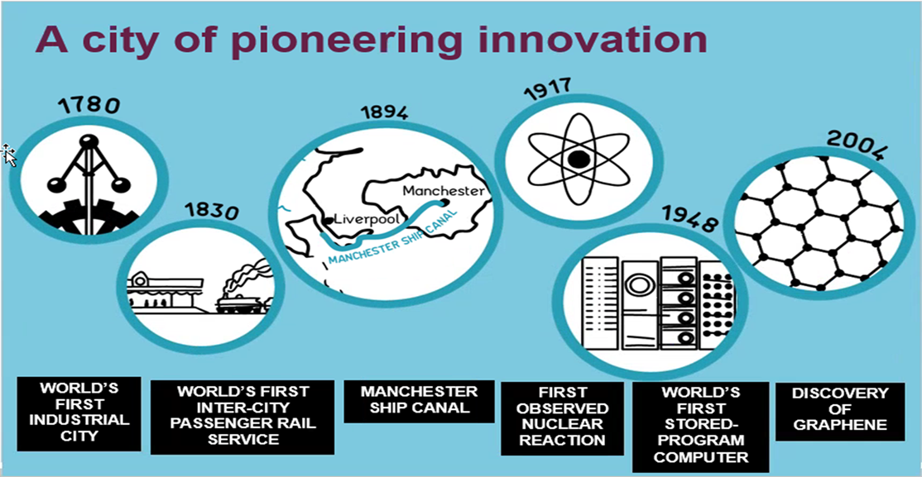
Manchester - a city of innovation
Picture - innovation timeline

Slide 4
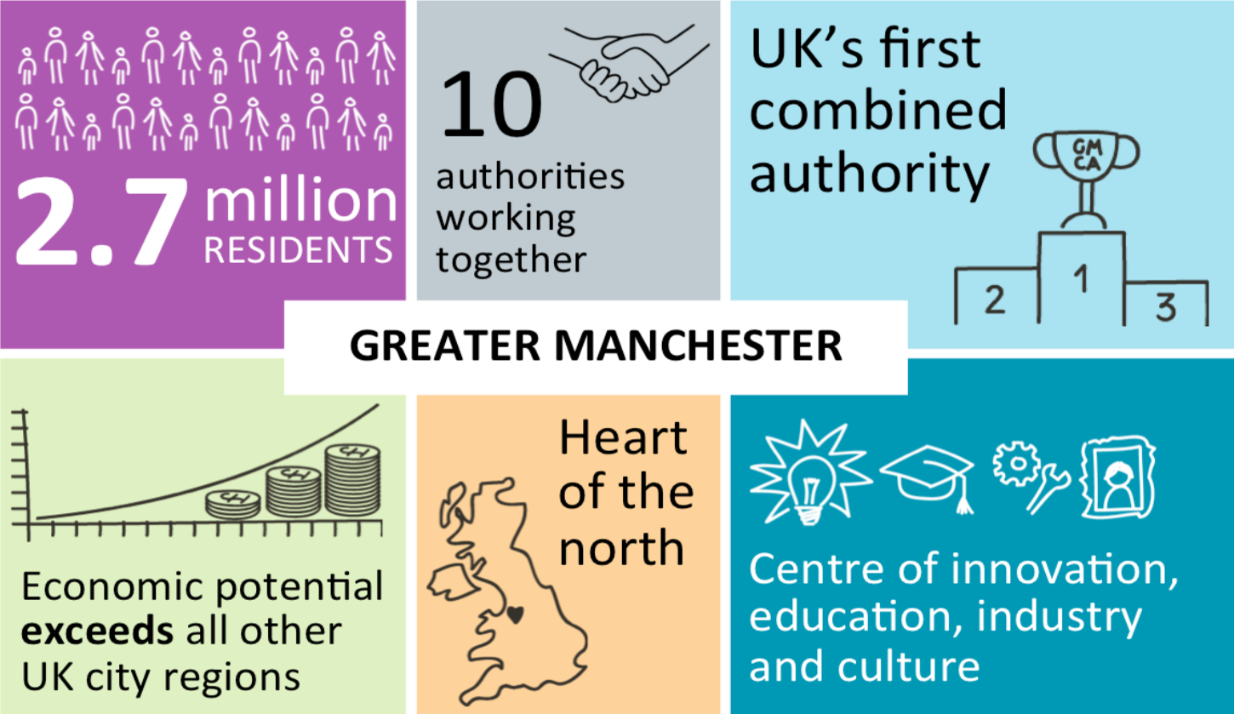
Manchester - Oxford Rd Corridor

Slide 5
Manchester - a leading smart city
Largest light railway network in UK - Metrolink is wholly publicly owned, clean transport system. Grew from a single line into a network. 8 lines, new zoning system, extra spur to Trafford Centre being built.
Health devolution - health and social care have been merged. MFT a single hospital trust bringing together Manchester’s hospitals (with Trafford), “LCOs”, local care organisations - 12 across the city.
GM devolution - a city-region mayor, Andy Burnham. GMCA is an 11th L.A. that sits alongside the other 10. More joint working. Responsibility for post-16 education, health, economic growth, transport, fire and police.
City centre growth: residential and business

Slide 6
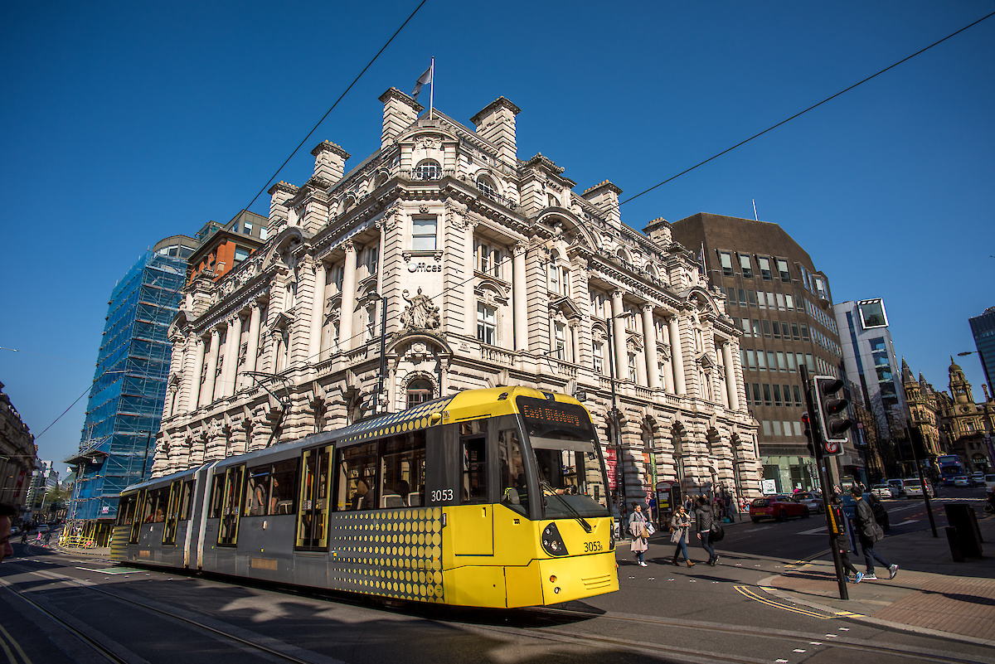
Manchester - a leading smart city

Slide 7
Manchester in a Changing World
Major international airport - expanding to be fit for the 21st century
Regional capital - with 2.5 million in GM, but double this in travel-to-work area
Large student population - universities as drivers of skills and innovation
Worldwide profile - football, music, culture
Longstanding partnership with Wuhan, China
Strategic partnerships across North America, Australasia, Asia.
Eurocities member, signatory to Covenant of Mayors.

Slide 8
What data do we have?
Cities do have a lot of data - but much of this is private, or related only to internal transactions; much of it is in legacy systems, or available via PDFs or other non Machine-readable formats.
“Real time data” - primarily operational, the data collected and used by real time systems for operational purposes. Often only accessible by those systems or those authorised to use them.
“Near real time data” - anything that is not “instant”, e.g. we may collect hourly or daily information about call centre usage for M.I. purposes.
“Static data” - doesn’t change very often - locations of schools, community centres, bus stops
“Geodata” - data used for G.I.S. and spatial mapping purposes inc. shape files and asset data. Usually accessed via proprietary systems.

Slide 9
Collecting Data
Smart City data is often new - as new applications and services get delivered.
Because it will be on the “cloud” - its likely to be outside of our normal city data architecture which was built for more traditional applications. The “cloud” allows us to scale provision.
It may not be us collecting the data - it may be central government (e.g. Defra) or it may a partner (e.g. TfGM), or it may be a private sector operator.
We have to comply with GDPR, but also with our responsibilities to ICO.
We have to consider the ethics of collecting data - whether we do it or private sector companies do it.

Slide 10
Collecting Data - Devices
Air Quality Sensors
Cameras
Wifi “sniffers”
Bluetooth Beacons
Mobile Phones

Slide 11
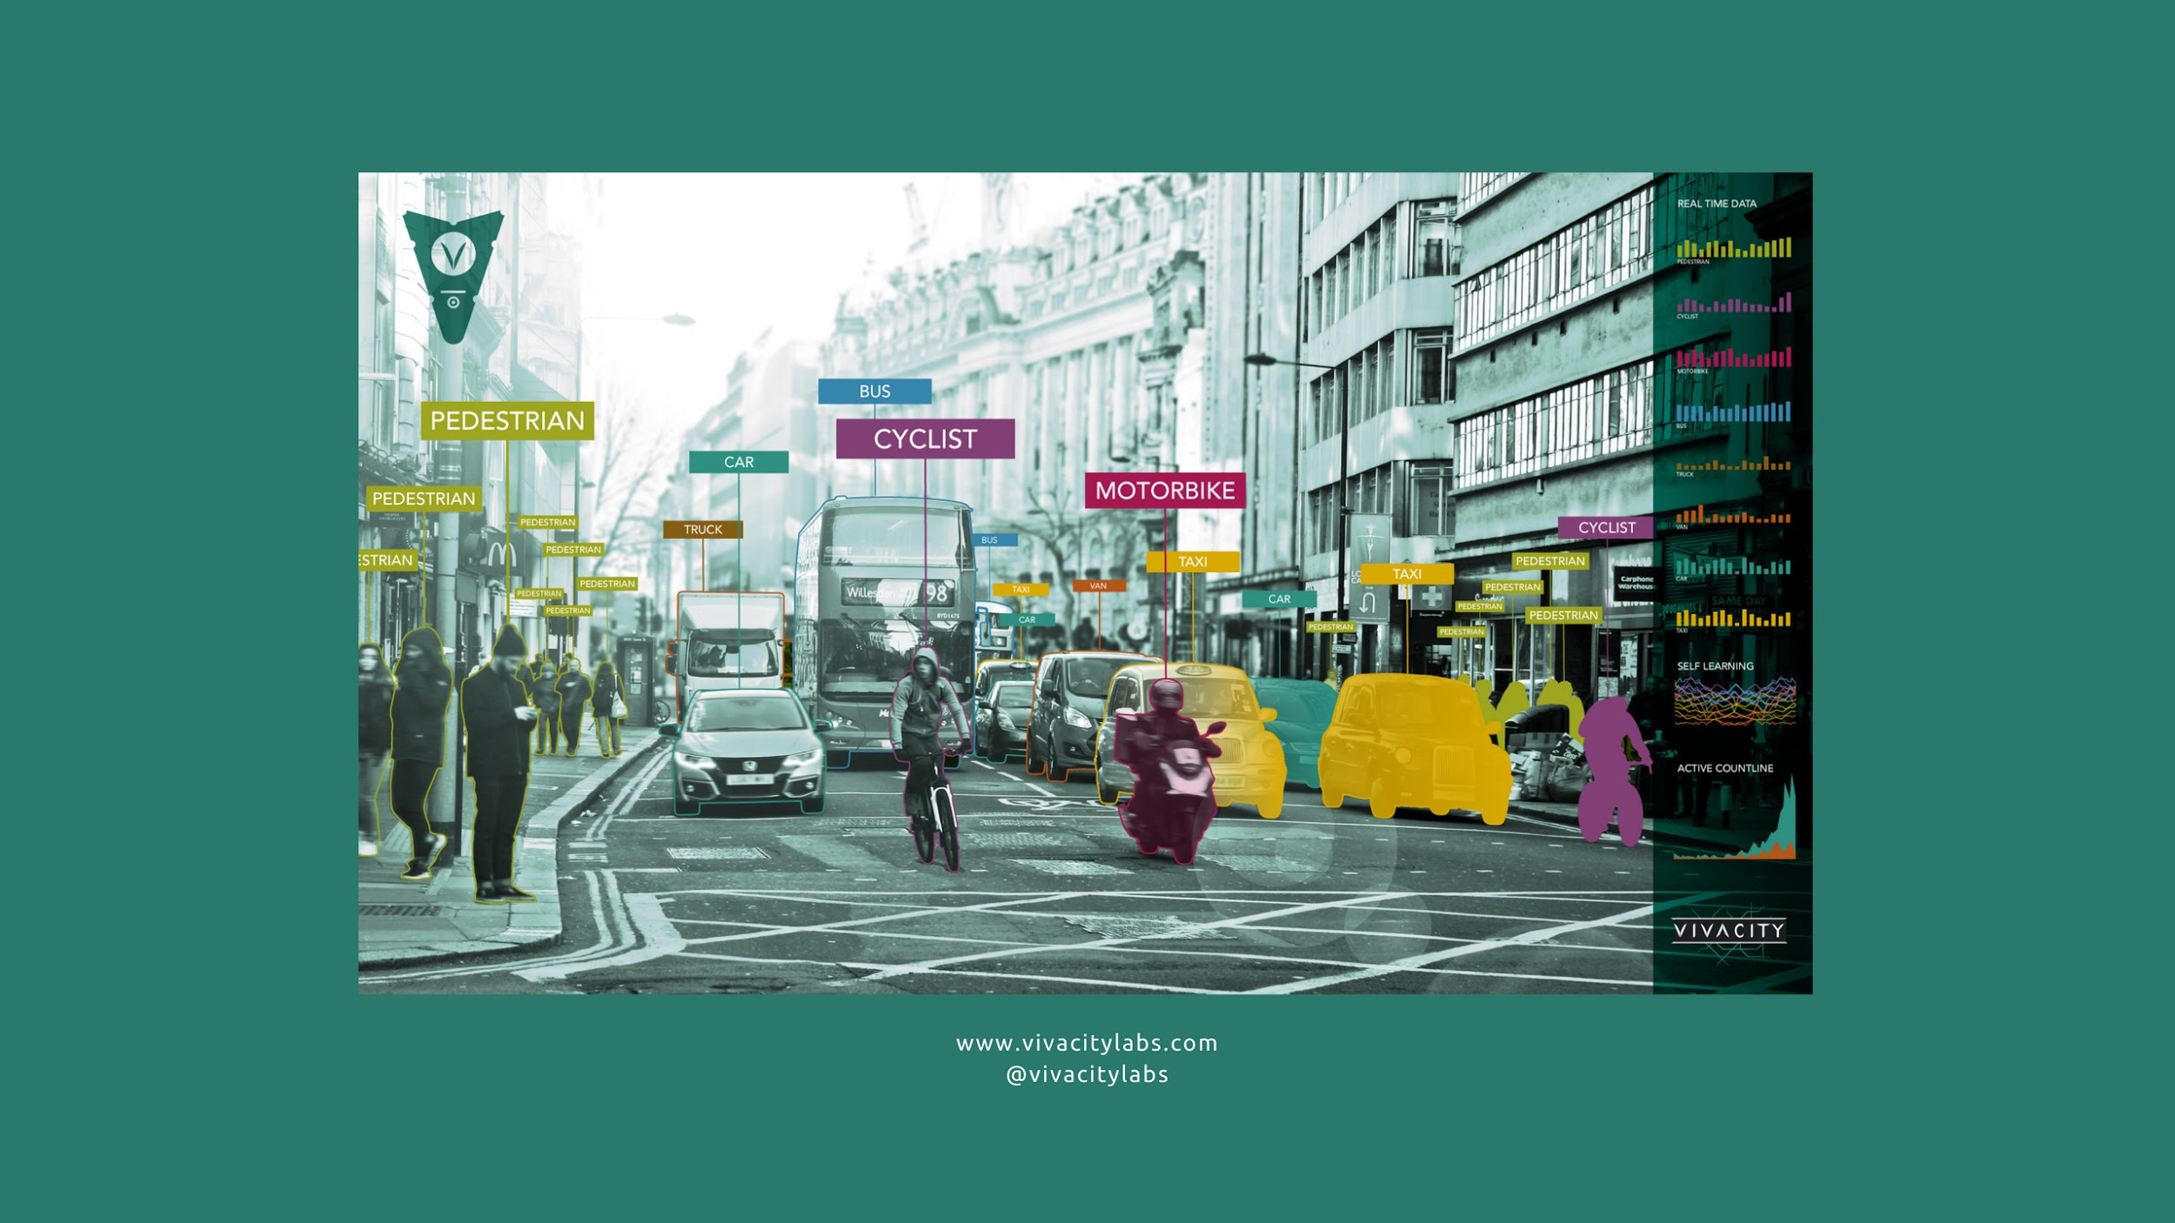
Collecting Data
Tracsis cameras or Retail Sensing cameras

Slide 12
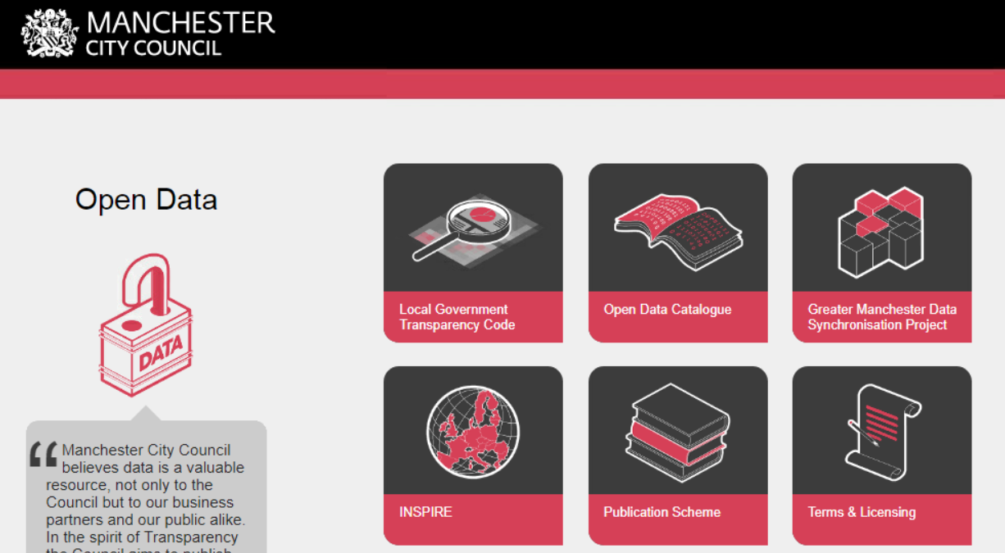
How do we make it available?

Slide 13

How do we make it available?

Slide 14
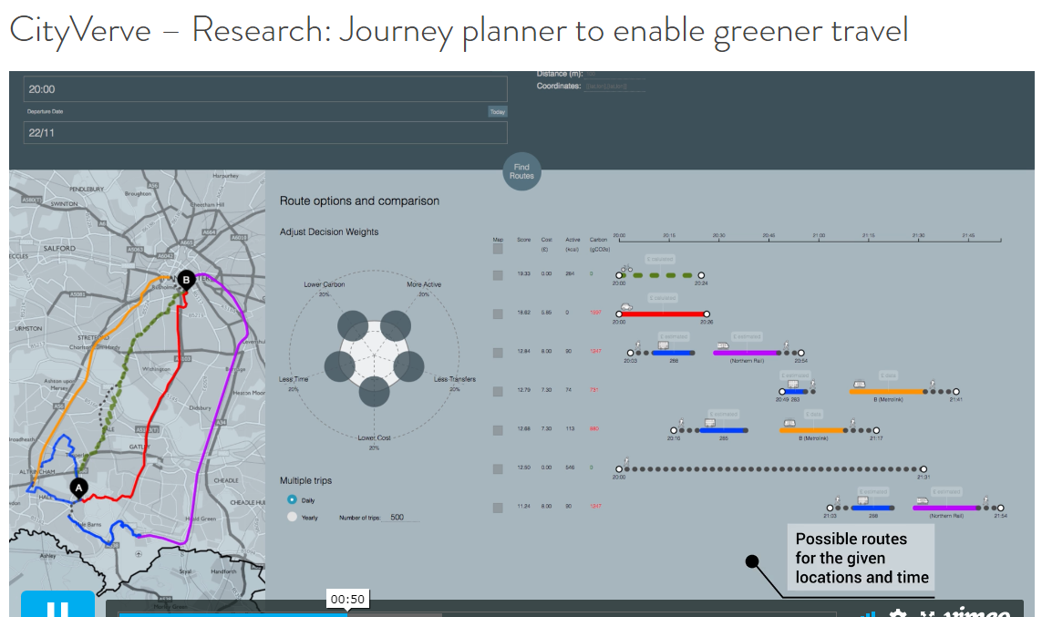
What do we do with it?
www.complexurban.com (MMU School of Architecture)

Slide 15
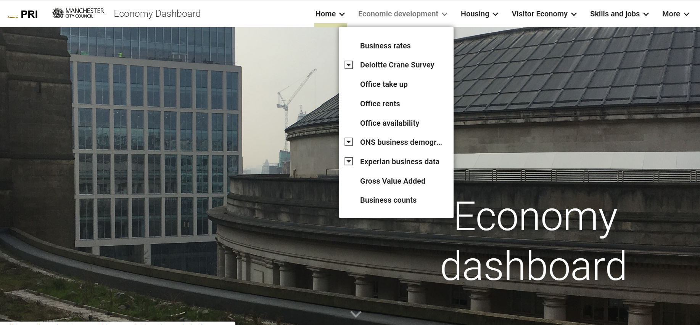
What do we do with it?
www.complexurban.com (MMU School of Architecture)

Slide 16




From Projects to the Mainstream
EU Horizon 2020 “Lighthouse” 2015-20 https://www.triangulum-project.eu/
I
nnovate UK City IoT Demonstrator 2016-18
https://cityverve.org.uk/
EU Horizon 2020 IoT “Large Scale Pilot” 2017-19
https://synchronicity-iot.eu/
EU URBACT Action Learning Network 2016-18
https://smartimpact-project.eu/
Triangulum Logo
Cityverve Logo

Slide 17
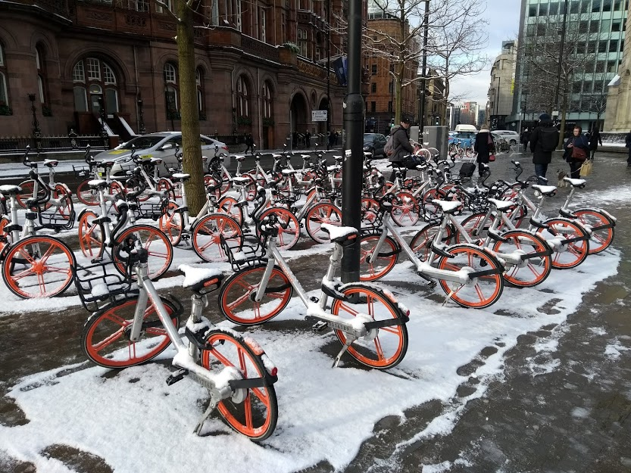
Working with Private Sector Data
MObikes in the snow

Slide 18
Next Steps
GMCA - Office of Data Analytics is proposed
GM Analysts Group meets regularly
Need for a city data architecture
Open Data Manchester looking at developing a Declaration for responsible and intelligent data practice
UK R&I “grand challenge” on A.I. and Data
We still have much to do to regulate and enable data sharing and to educate people about data

Slide 19
Thank You.
@adrianslatcher
a.slatcher@manchester.gov.uk

