Slide 1

Salford University
Smart Cities
Big data and ‘smart’ mobility
Dr. Richard Nickson
Account Director
elgin.org.uk

Slide 2





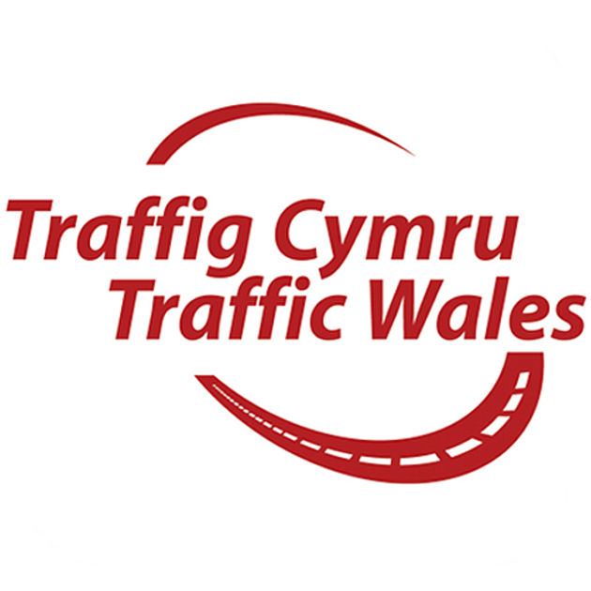









  Elgin – overview
Market leader in UK traffic management planning & monitoring technology providing solutions to:
UK local and strategic highway authorities
Utility companies (Energy, Water, Telecomms)
Consumer mapping and sat-nav providers
roadworks.org elgin.org.uk

Slide 3
  The challenge of managing transport network disruptions
Understand the impact of events, incidents and works (mainly) on the road route network, but particularly congested “key” routes
Improve coordination and management of works with events and other uses of road space
Enable real time monitoring, management and intervention
Influence driver behaviour through real-time active traffic management – a ‘nudge’ towards other mode / timing choices
Aggregate information to provide meaningful intelligence for future connected vehicles
roadworks.org elgin.org.uk

Slide 4
  Key objectives
Integrate information from (often) disparate systems – e.g. SWR, UTMC and open source / open standard – a mixed ecosystem.
Provide a seamless map based view of the road network with real-time traffic information
Reduce planning & coordination risks: right first time, every time – especially for bus service route disruptions across the region
Enable multi-agency access to easy to use, but powerful map-based tools
Enable integrated communication from a “single source” of truth by aggregation of data from a range of relevant sources
roadworks.org elgin.org.uk

Slide 5
  How do we achieve this?
An integrated network management toolkit in conjunction with existing workflows to meet the challenge of fewer resources and greater demands
Provide a common approaches to Traffic Management, Communications and Real Time Monitoring / influencers
Enhance available information: e.g. highlighting Key Road Network and provide programmatic tools to recognise clashes
Communicate via social media / consumer apps
Serialise aggregated data to confirm to (as yet to be developed) open data standards that connected vehicles can use to make / inform decisions
roadworks.org elgin.org.uk

Slide 6
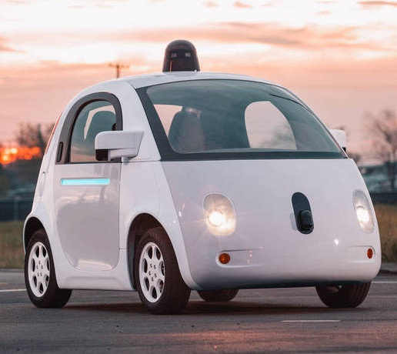
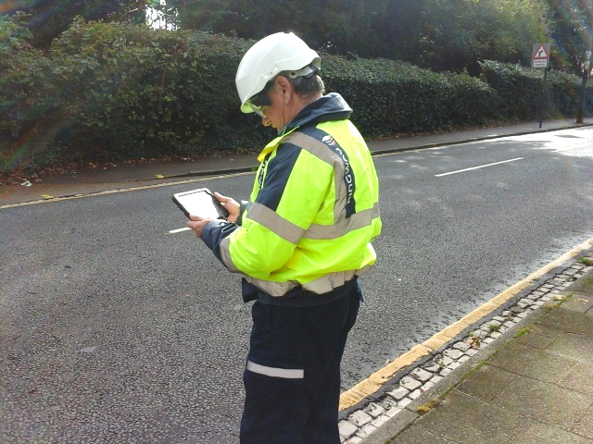

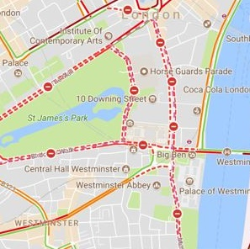
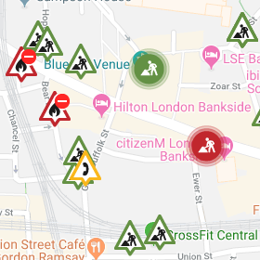

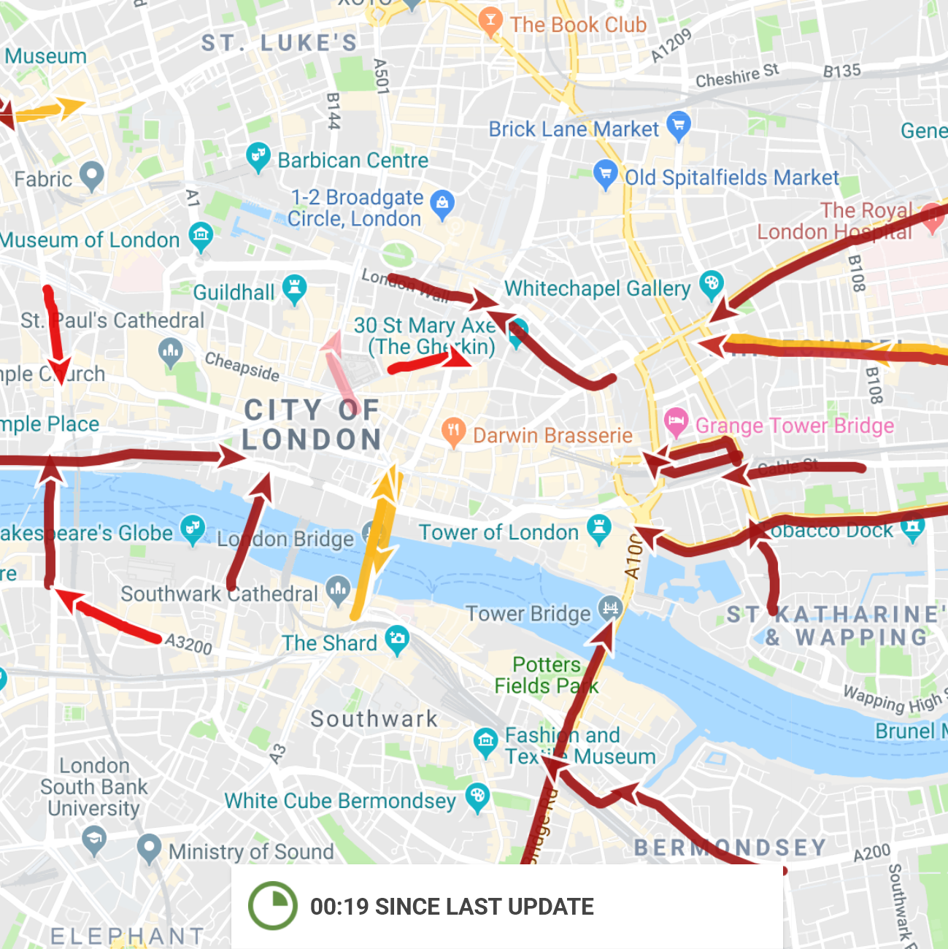




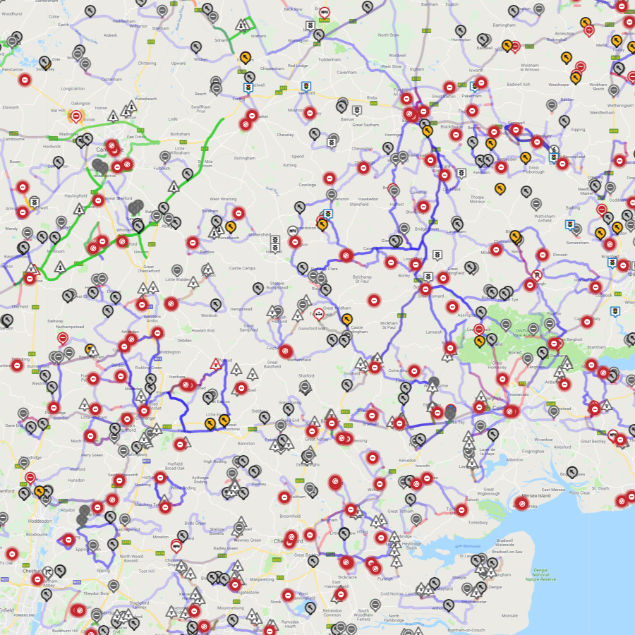
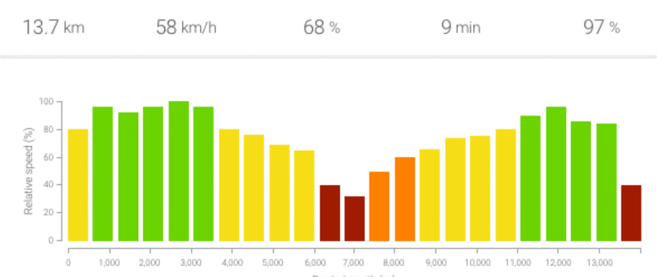
  Elgin Platform
Real-Time Communication
Influencing driver behaviour
Real-Time Monitoring
Network monitoring with better signal-to-noise ratio
roadworks.org
Comprehensive map of roadworks and traffic disruptions
Communicate
Monitor
Elgin
Plan
Analyse
Traffic Disruption Analytics
Historic roadworks and traffic data analytics to support better planning
Works & TM Planning
Multi-agency collaboration for planned traffic disruptions
roadworks.org elgin.org.uk

Slide 7









  Multiple data sources: “one network” single source of truth
  Integration of real-time data from disparate UITMC systems and other sources such as TomTom, Google and Waze
CCTV & IOT
Live roadside updates
Public transport data
Roadworks
& traffic management
Floating vehicle data
Crowd sourced data
Monitor
Incidents
one network
roadworks.org elgin.org.uk

Slide 8
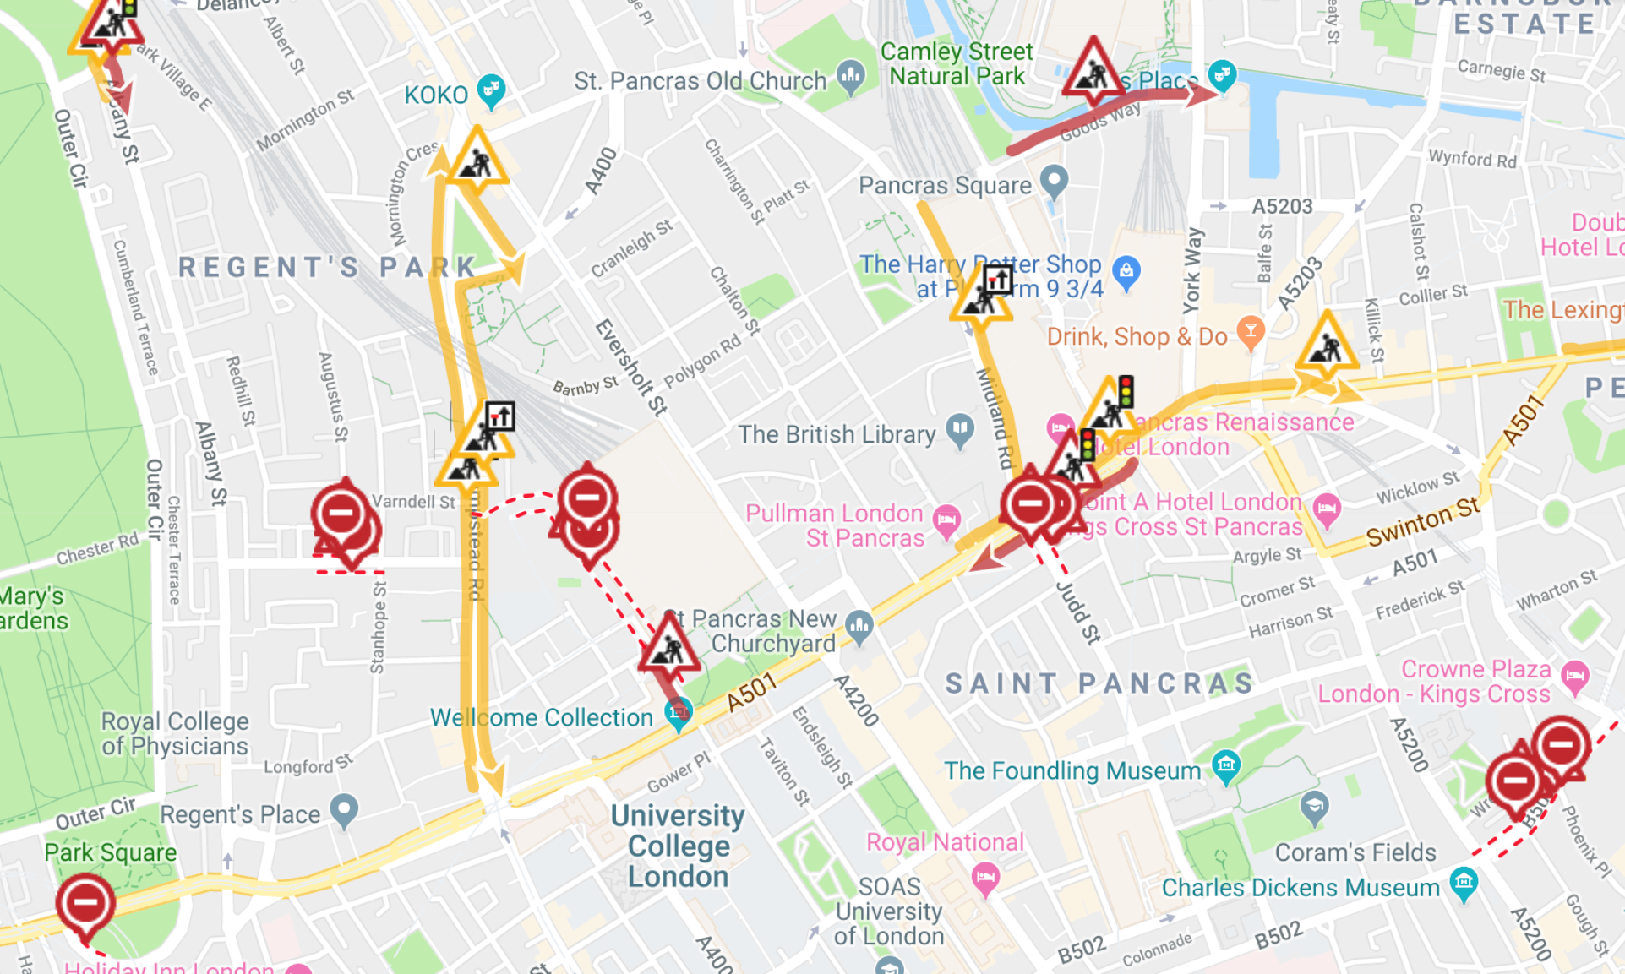
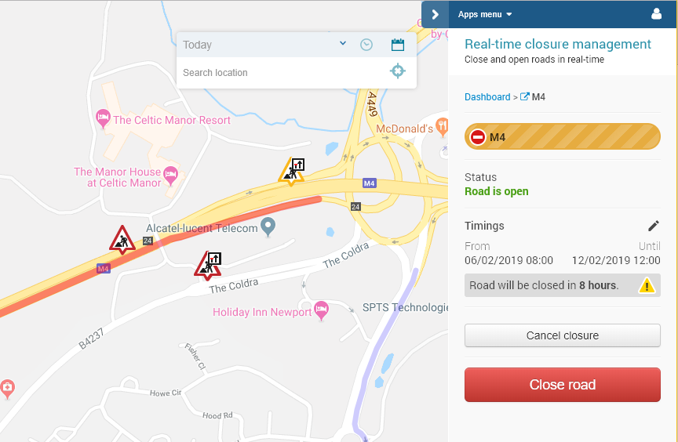
  Real time Monitoring & incident management – reducing the “noise” with crowd sourced floating vehicle data
  Real-time monitoring of abnormal congestion associated with roadworks. User can toggle between view of all currently active works and those works that are causing a significant impact on the road network, showing live traffic speeds, queue length and journey delay.
  Real-time activation of closures triggering rules-based alert strategy. Intuitive, simple user interface with responsive design enabling updates to be made from mobile devices on site.
roadworks.org elgin.org.uk

Slide 9
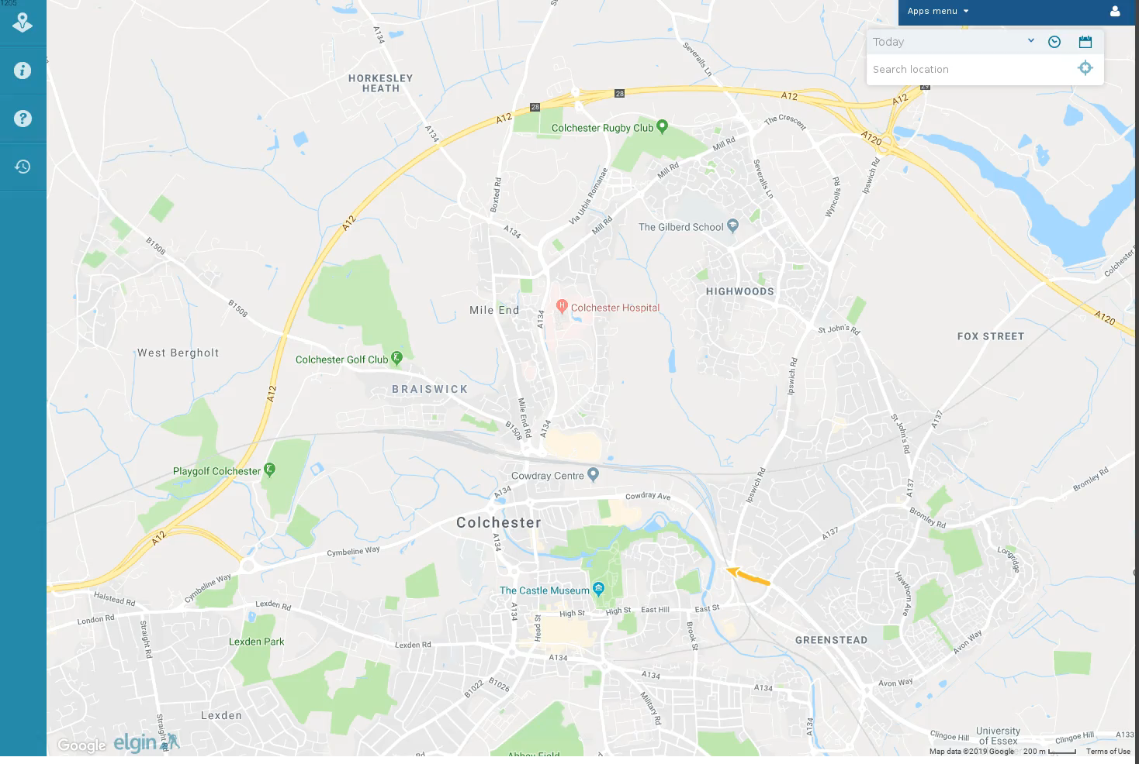

  Smart data: “what happened when?”
  Replay historical traffic conditions, roadworks and other disruptions.
  Visualise traffic responses to previous traffic management interventions
  Play video
roadworks.org elgin.org.uk

Slide 10
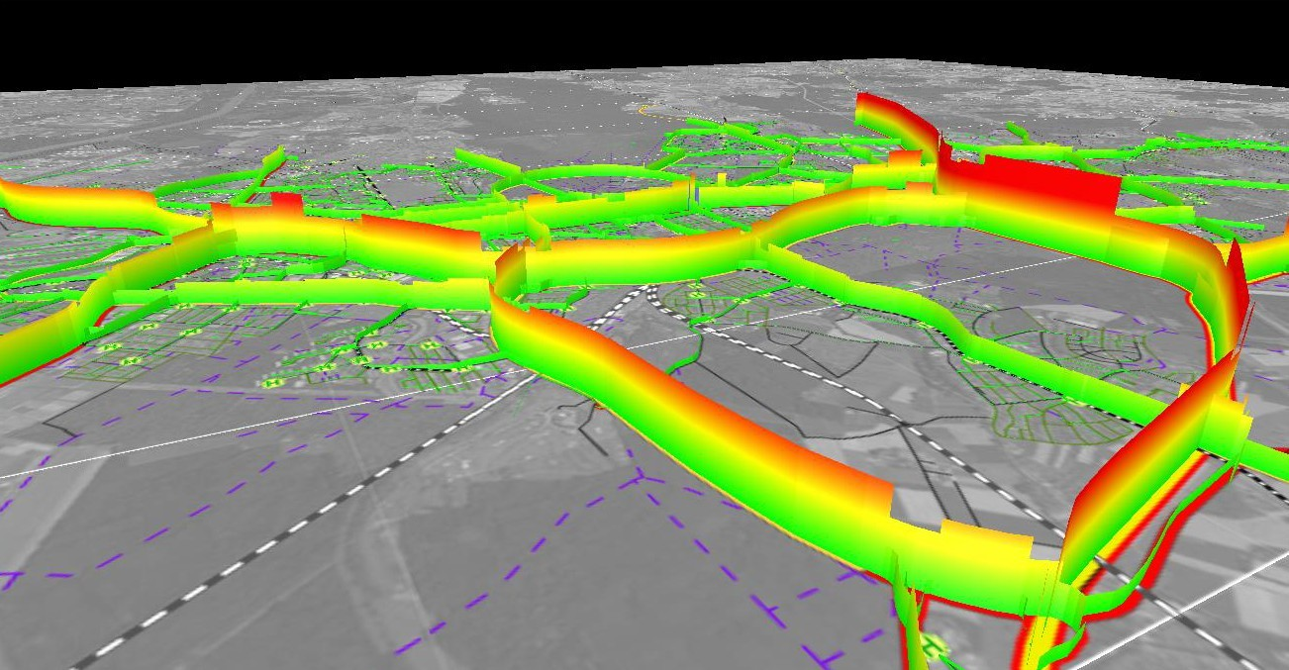
  Future of smart data: “what will happen if…?”
  On demand simulation of traffic impacts of planned traffic management – to improve operational decision making
roadworks.org elgin.org.uk

Slide 11
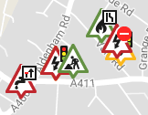

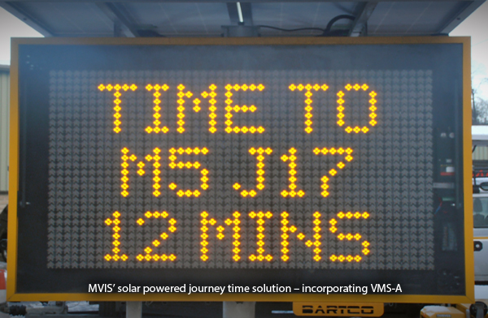

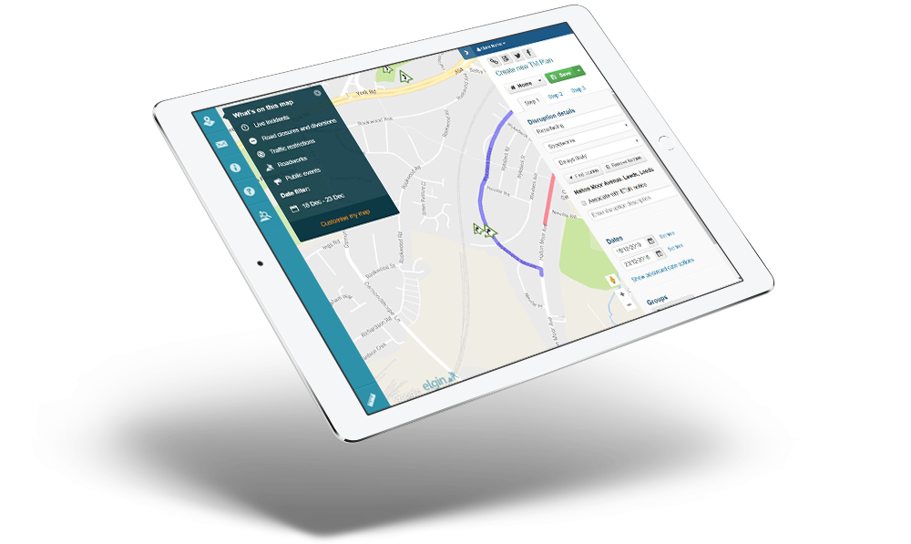





  Communication: multiple channels – “single source of truth..”
Multi-agency coordination portal
VMS
Sat-nav live updates
one network
public website
Communicate
Dynamic traffic management CAV feed
Map apps live updates
Social medial, email & SMS alerts
one network
roadworks.org elgin.org.uk

Slide 12
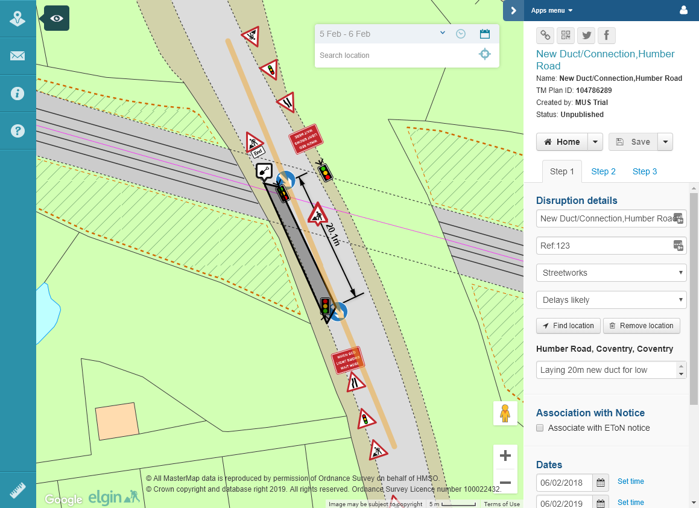
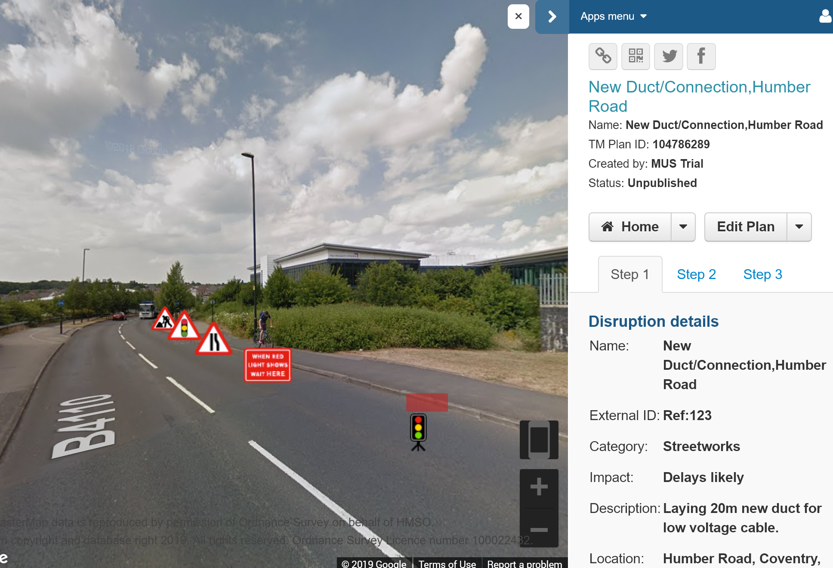
  Traffic management planning – the future role of smart equipment and VR
  Define detailed traffic control and signage layouts within the road space booking workflow. Intuitive UI requires minimal user training.
  Visualise traffic control and signage layouts within Google Streetview virtual reality environment supporting risk assessment, etc.
roadworks.org elgin.org.uk

Slide 13
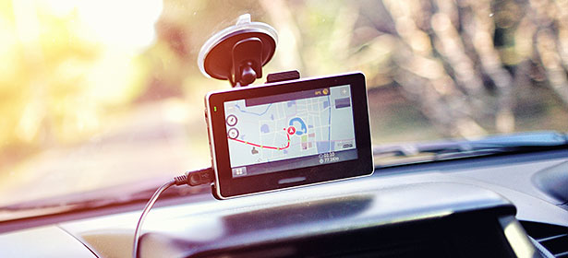
  Influencing Driver Behaviour
  Most major cities in the UK cannot communicate the closure of a major road reliably, authoritatively and in real-time to a driver via their sat-nav
  But Greater Manchester can!
roadworks.org elgin.org.uk

Slide 14
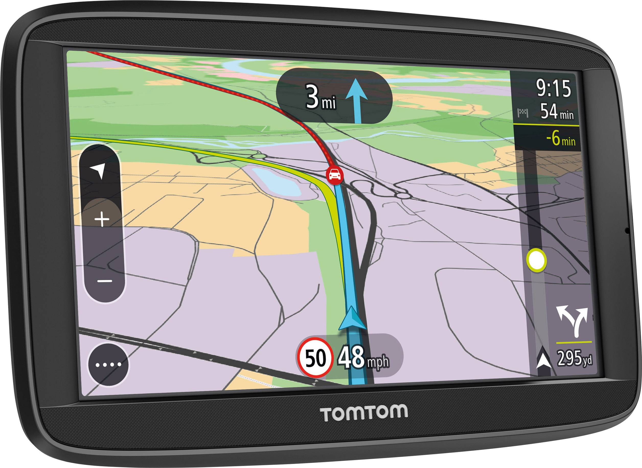
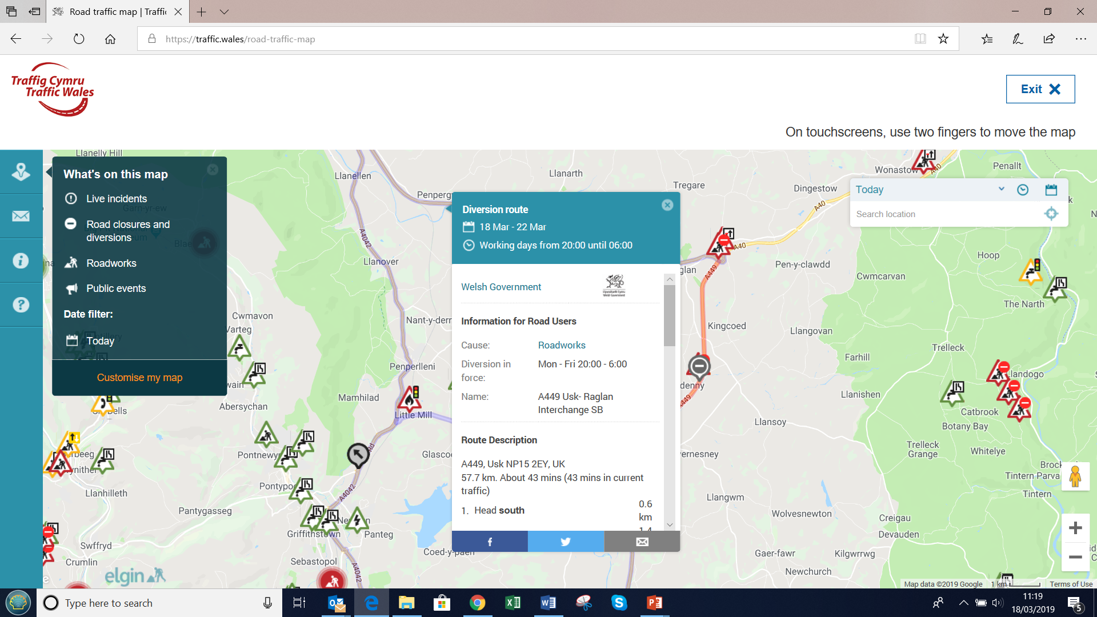
  Communication
roadworks.org elgin.org.uk

Slide 15
richard.nickson@elgin.org.uk
elgin.org.uk

