Slide 1
Walking motivations, perceived benefits and the role of outdoor education in walking promotion. Nora Morocza and Professor Tim Stott School of Sport Studies, Leisure and Nutrition, LJMU Sustainable Transport Futures Seminar Series, University of Salford
Dr Liz Mahon, School of Sport Studies, Leisure and Nutrition, LJMU)
Dr Lynne Boddy, School of Sport and Exercise Sciences, LJMU
Dr Jo Frankham, School of Education, LJMU
Jacqueline Reilly, Institute of Health and Wellbeing, University of Glasgow
Professor Richard Mitchell, Institute of Health and Wellbeing, University of Glasgow

Slide 2
“Until now, I have tried the obvious explanation, the one you turn to because it’s quick and easy and the opposite of the essence of walking, which is slowness: I explain that he who walks lives longer. The memory sharpens. The blood pressure falls. Your immune system gets stronger. But each time I said it, I knew it was only half the truth. To walk is something much larger than a list of advantages you can read in an ad for vitamins. So what is the other half of this truth?”
Erling Kagge: Walking, one step at a time

Slide 3
MPH: The impact of walking on health attitudes and behaviour and environmental attitudes and pro-environmental behaviour.
Longitudinal qualitative study
Paths for All Health Walk participants (mean age: 65)
Health awareness
More active lifestyle
Active transport
Connectedness to nature
Ecological awareness
Pro-environmental behaviour
Health and body awareness
Holistic approach to health
Interconnected-ness with environment

Slide 4
Motivations for and benefits of health walks groups
Walking group participation
Social aspects
Extra motivation- accountability (commitment to the group)
Routine
New stimulus*
Safety
Available facilities
Accessibility (location and level of walks)
Walking
Health
Physical health: fitness, stamina, dealing with chronic health condition, e.g. arthritis
Mental health: social inclusion, restorative experience, self-esteem and satisfaction
Health and body awareness
Hobby
Nature/outdoor
Achievement (and associated mental health benefits)
“I don’t know I don’t really psychoanalyse it too much, I mainly do it because I enjoy it, right, even if it didn’t have this benefits I would still walk. But there’s a bonus that there are these other benefits that helps your health.” (F, 63)

Slide 5
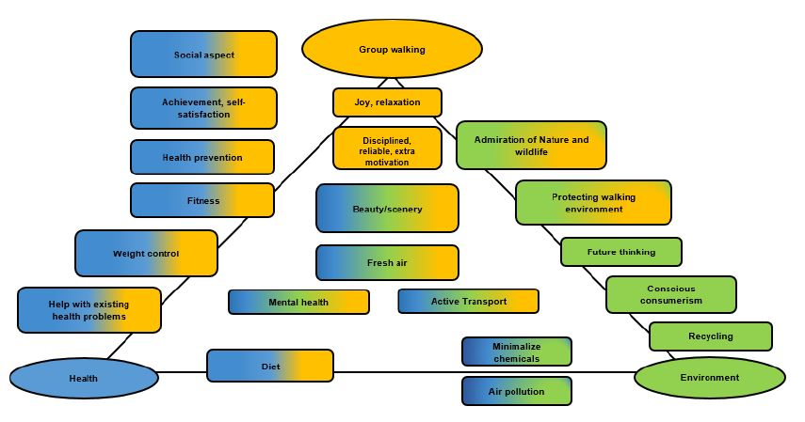
Active transport reason: decrease CO2 emission
Active transport choice:
Length of journey
Purpose of journey
Health walks
Increased fitness
Ability to walk for transport

Slide 6
Lessons learned
Walking group participation
Recommendations
Large fluctuation
After 6 months:
1 respondent stayed in the same walking group
2 switched to other walking groups (with the same organization)
3 did not participate in organised walking anymore
Walking (and active transport) programme focus
Building communities
Address safety concerns
Only works long term if there is genuine care/friendship between members.
Providing variety
Constant new stimulus is needed?
Focus on the enjoyment aspect

Slide 7
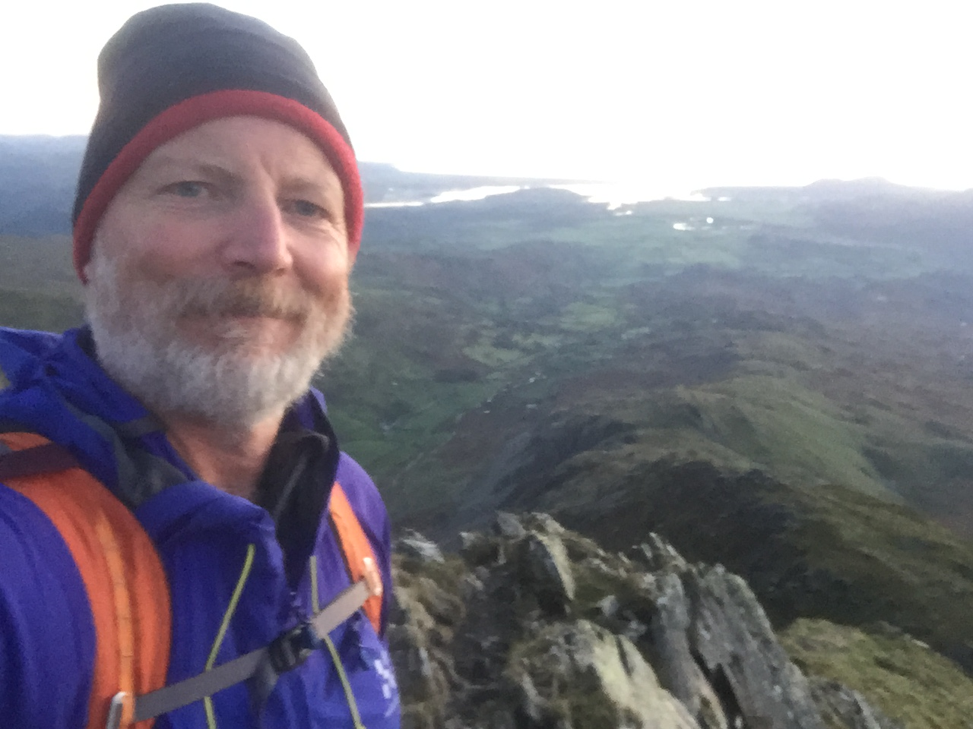
PhD: The health and social benefits of walking and walk leading with HF Holidays
Why?
Tim Stott
Professor of Physical Geography & Outdoor Education
Liverpool John Moores University, UK
(E: t.a.stott@ljmu.ac.uk)
Sustainable Transport Futures Seminar Series,
Salford University. 30 May 2019

Slide 8
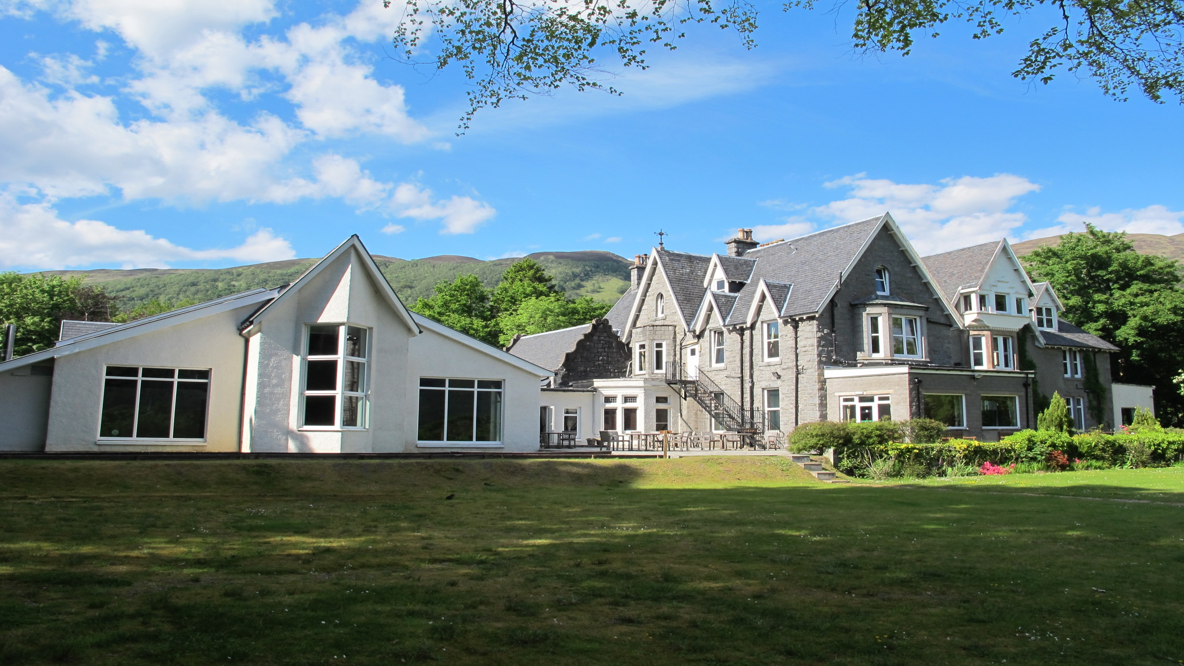
I decided to join HF as a Volunteer Leader in 2012
A 2-day assessment in Lake District
2 years probation: leading at Sedbergh, Glencoe, Dolgellau, Beddgelert, Keswick
Then assessed to lead abroad in 2015.
Attended the annual conference, met the Director
Opportunity within LJMU to apply for internal PhD funding (rare)
Made 2 applications: 1 to study HF guests (17 applications); the other to investigate the use of UAV (drones) in teaching geoscience (2 applications) – both were funded
Leads abroad: France (2016), Croatia (2017), Corsica (2018)

Slide 9
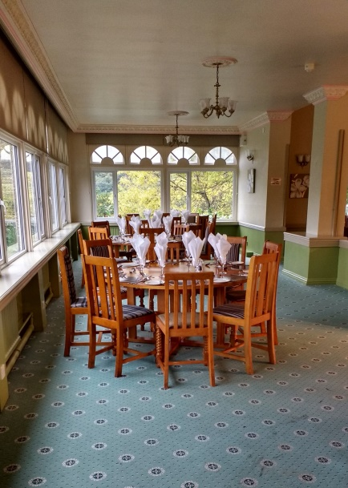
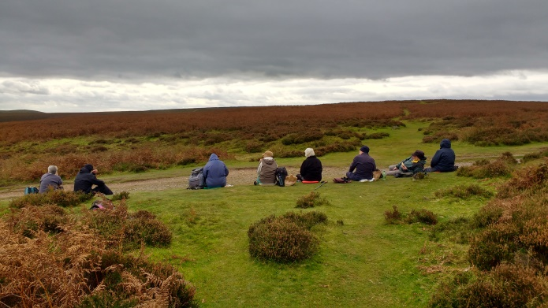
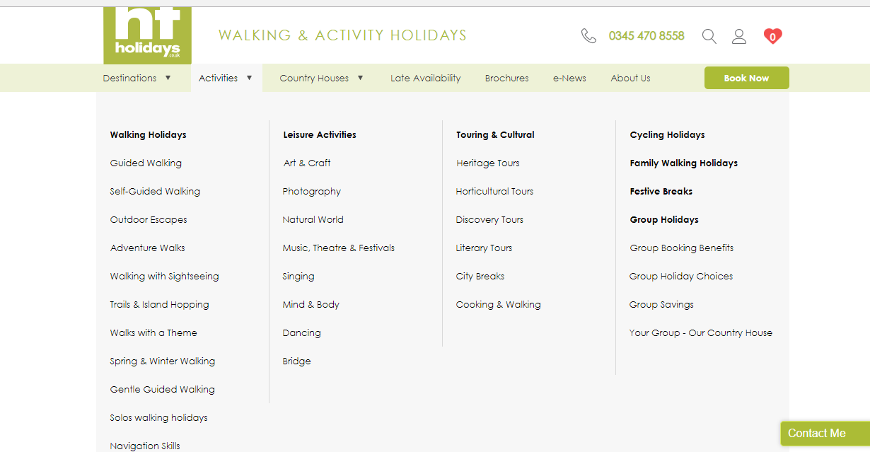
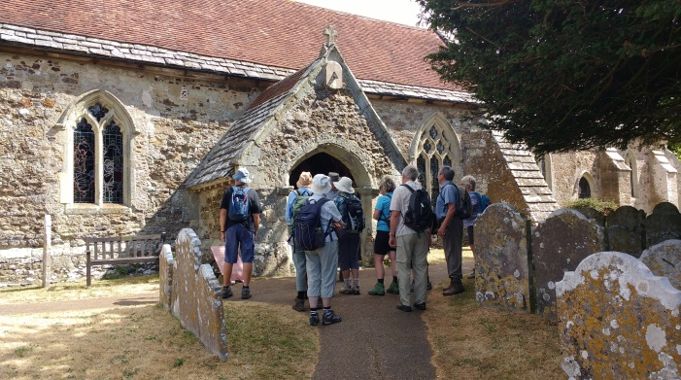
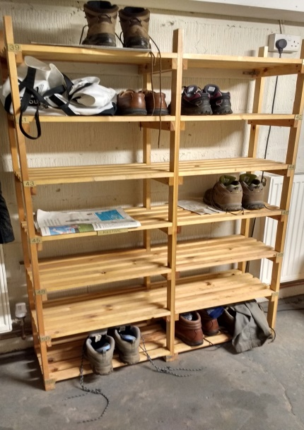
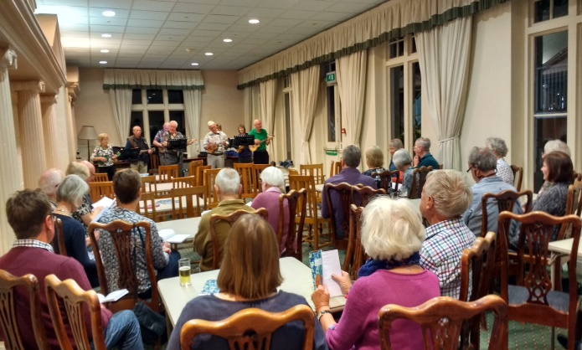
HF Holidays

Slide 10
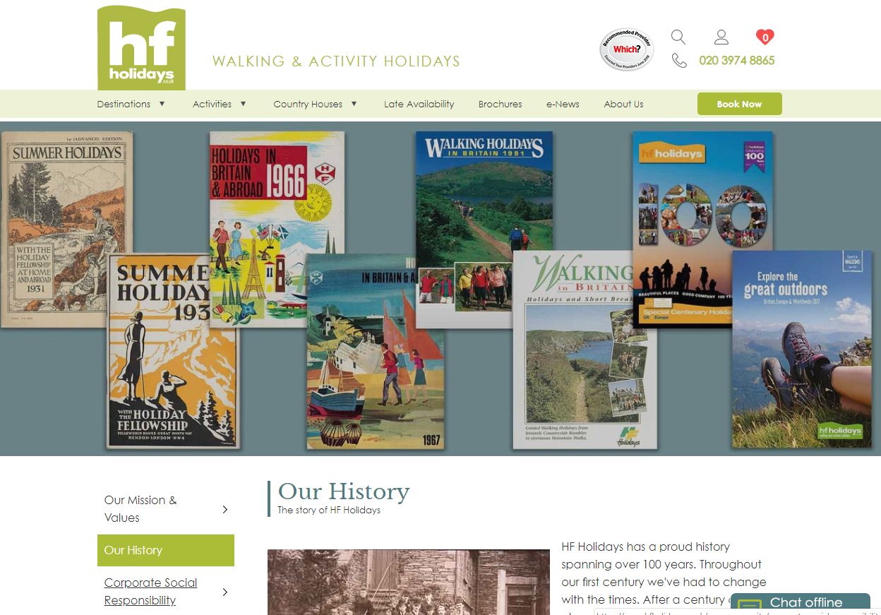

Slide 11
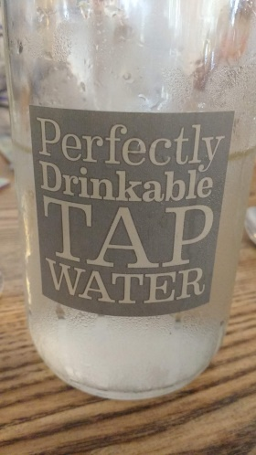
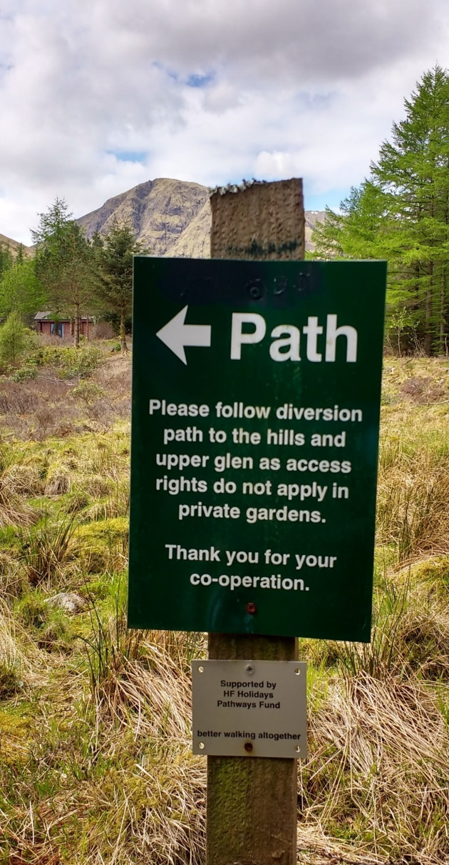
HF Holidays values
Co-operative society:
Governed by the Board of Directors (members elected)
Membership by shareholding

Slide 12
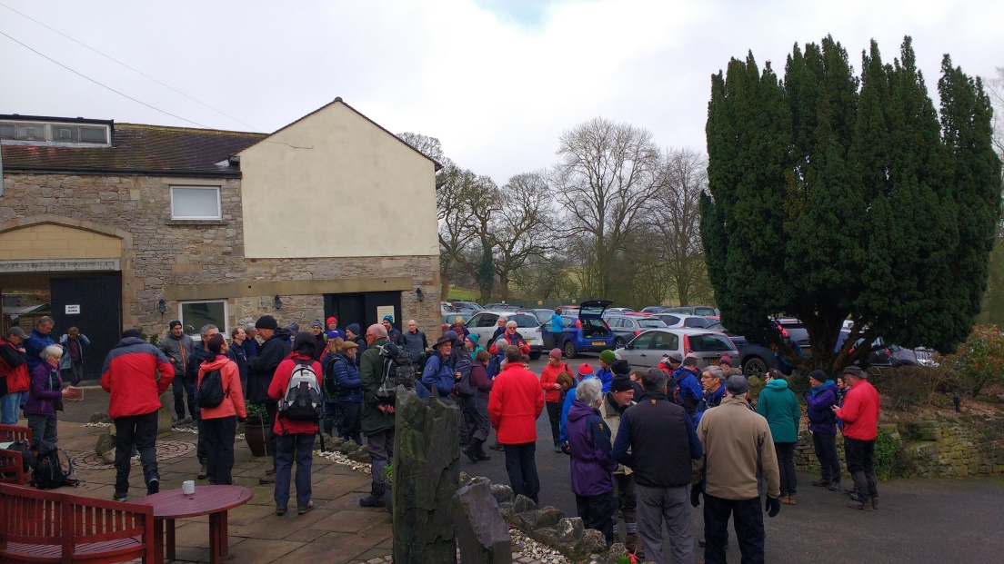
HF Holidays’ people
Walk leaders
Approx. 700: volunteers (get accommodation, food, training, travel expenses)
Mostly educated, middle/upper-middle class, retired or close to retirement (median age approx. 65)
Had been walking most of their life
Holiday guests
Educated, middle/upper-middle class
Most prominent age group: 60-70 years old (mode: 69 in 2015)
Returning guests:
Childhood-family holidays
Older adulthood: often singles
Key motivations for holiday
Social: meeting new people, group walking
Nature: flora and fauna
Learning: exploring interesting places - guided tours, local speakers
Local food
Comfort, safety

Slide 13
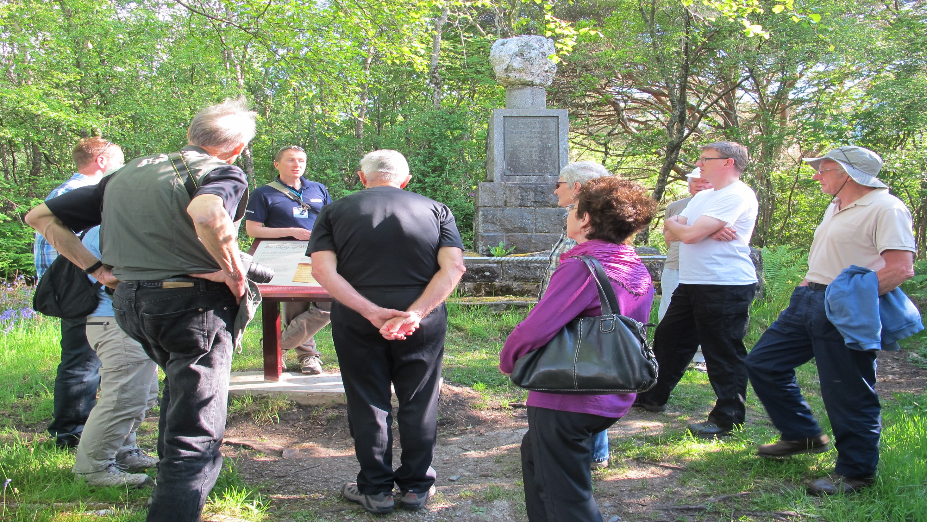
I met guests who were in their mid-late 80s who had kept
coming back for 30-40 years !! ??

Slide 14
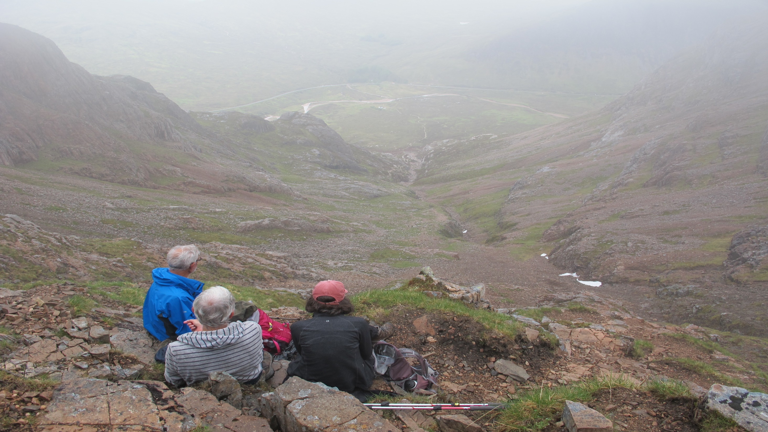
So…..why, what motivated them – what could we learn about
them and this organisation that could be applied to other
sectors of the population ?

Slide 15
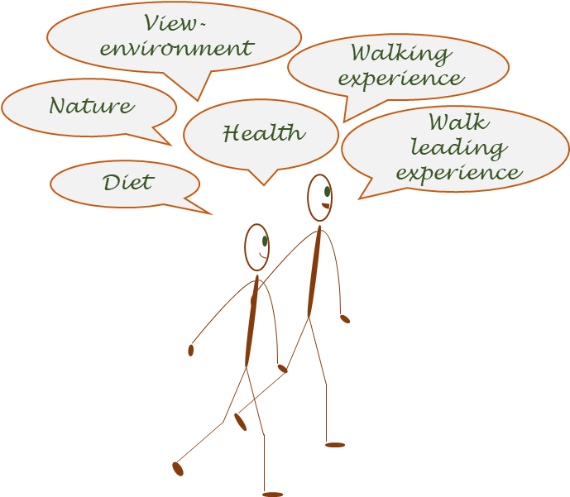
Study designs
Walk leader study
Hillwalking interviews
Yorkshire Dales: 5.5 km, ~200 m ascent
Holiday guest study
Group interviews on holidays
Glencoe: mountain environment
Shropshire Hills: moorland environment
Isle of Wight: lowland environment
Walking experience
Walking holiday benefits
Walking motivations
Group vs individual walking
Walking holiday motivations

Slide 16
Preliminary results
Primary motivations
Pleasure
Nature, fresh air
Stress release
Escape
Embodied and embedded experience
Nature, landscape
Environmental awareness
Spirituality
Personal history - walking history
Balance
Everyday life - walking
(responsibilities - hobby)
Energy intake - energy expenditure
Social activities - solitude
Achievement
Self-esteem (satisfaction)
Invigorating tiredness
Environmental challenges-
“Survival skills”
Adaptation and flexibility
Walking circumstances
Nutrition
Life changes - walking
Capabilities, barriers

Slide 17
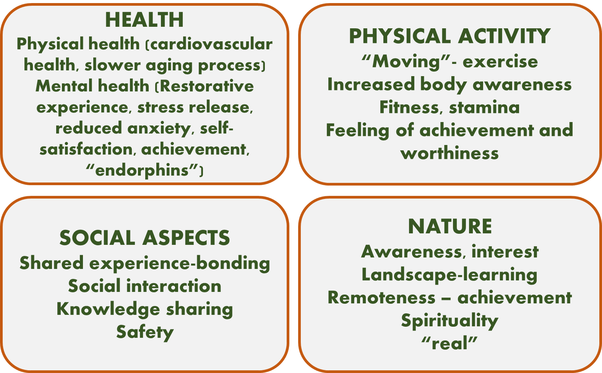
Perceived benefits
Walking
Walking holidays
Social:
Meeting and spending time with new people
Group mentality- team
Safety
Helps to get back into a walking routine-confidence
Learning
From people-diverse origin
About landscape, nature, cultural landmarks
Local food
Comfort, organised-no responsibility
Walk choices (3 levels)
Structure (regiment)-freedom balance
Activities
Oblige the leader!

Slide 18
Walking activity outside of holidays
Walk leaders
Regular activity
Local walk leading
Training for leading
Individual or small group (friends) hill walking for pleasure- different focus
Freedom
Risk taking- more difficult routes and walking environment
“Munro bagging”
Active transport
Depends on distance and time commitments
Approx. half of the leaders reported regular walking or cycling for transport
Guests
Recreational walking trips: depends on access (e.g. home location)
Walking groups at home (incl. friends, family)
Opening up: side-by-side
“Training” for holiday
Active transport (when time/weather allows) - 2 main attitudes:
Walking as a principle- active transport
Walking as recreation: nature based
Barriers: work and other commitments, health*
Group walking challenges - adaptation: pace, people, points of interest

Slide 19
Further directions
Study 3- in preparation
Quantitative questionnaire based project with both holiday guests and walk leaders
Hillwalking motivations and perceived benefits
Walking related physical activity
Perceived abilities and skills
Values questionnaire (socio-political, environmental, personal)
Environmental awareness and attitudes
Nature connectedness

Slide 20
Moving towards promotion
Variety/ new stimulus
Familiarity/
comfort
Abilities
Skills
Personal life demands
Infrastructure
Sustainability?
Safety concerns
Desired outcome, i.e. motivations
Potential barriers
Accessibility
“Utilitarian” walking
Recreational walking
Mountaineering
Different attitudes- different promotional messages
Engagement sustainability?

Slide 21
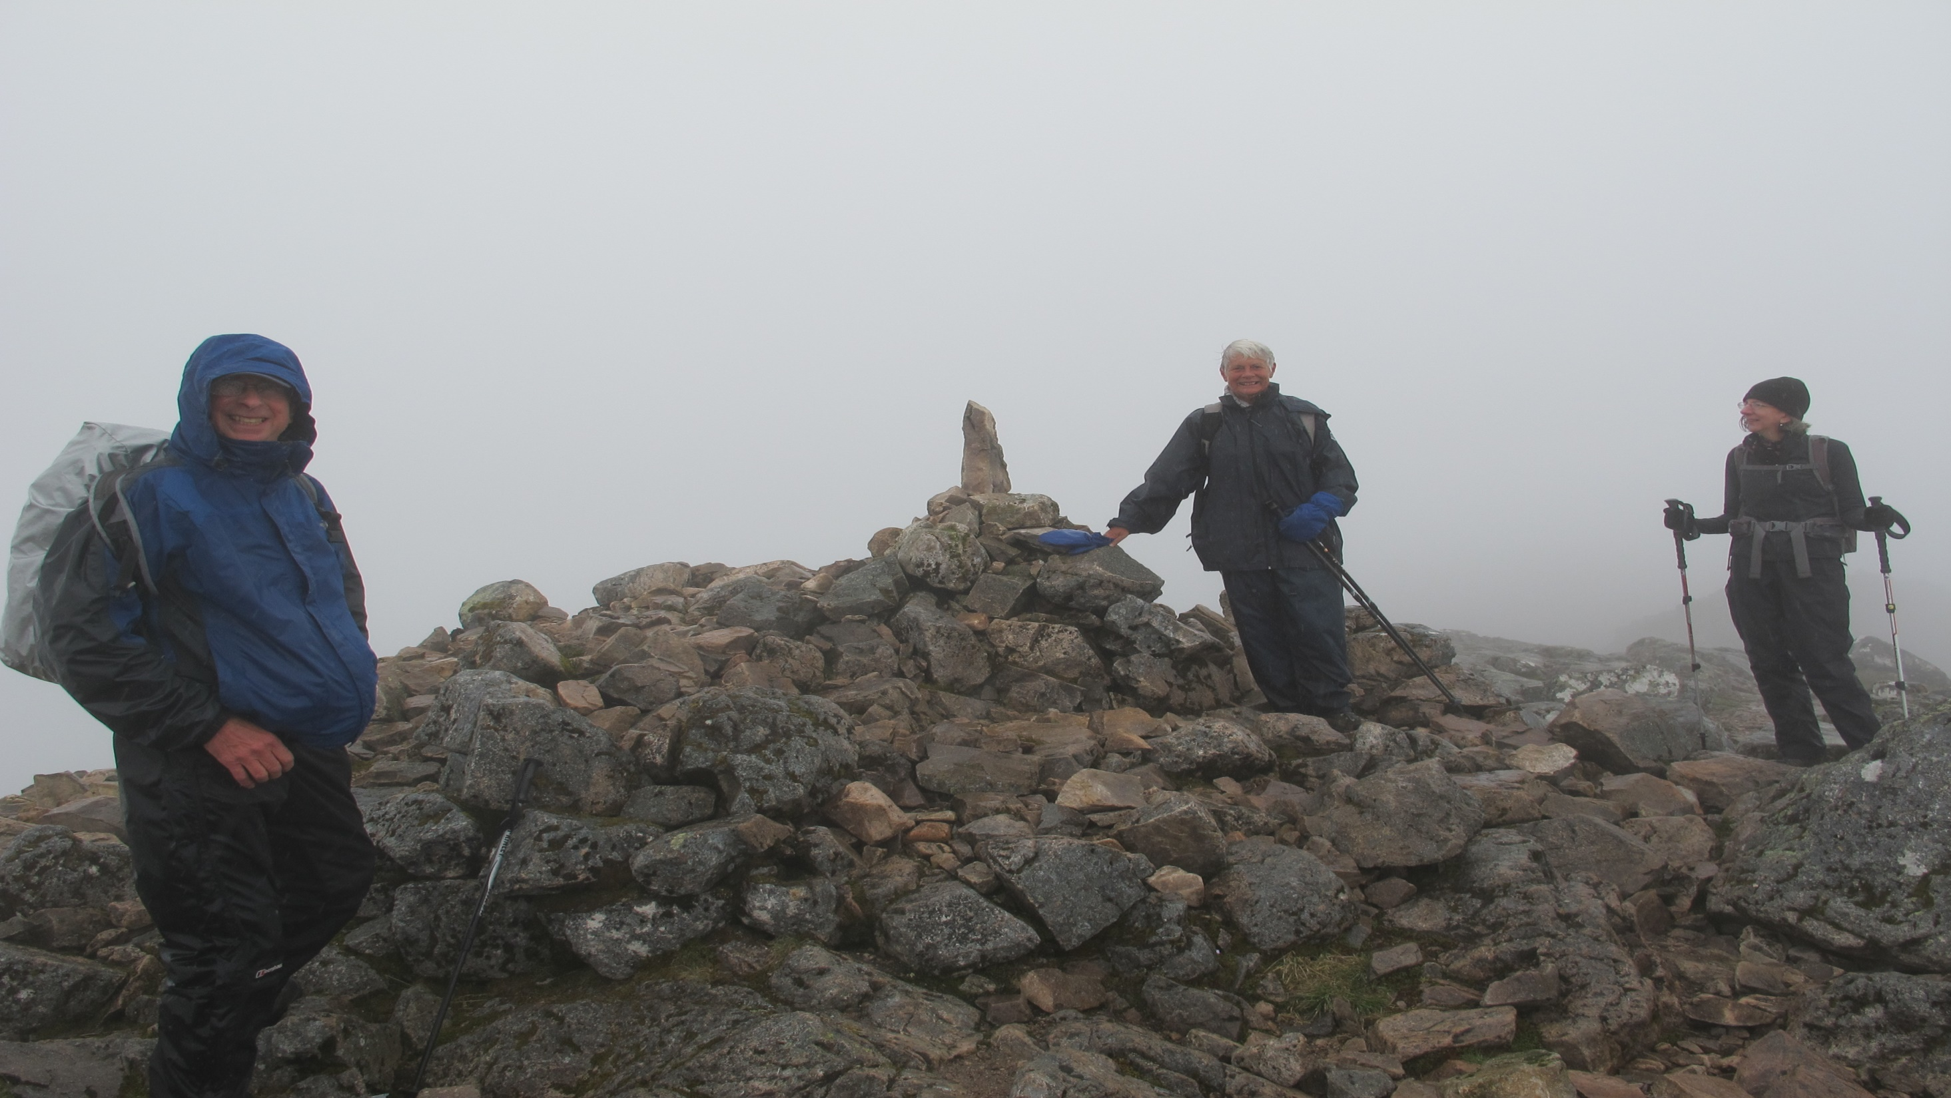
My perspective as a walk leader
Choice of walks: Easier (5-10km); Medium (7-12 km); Harder (8-16 km)
Defined/advertised routes – leader must follow exactly; risk assessed routes; field officer; update book; pre-booked transport (only 1 day walk back to the house/hotel); usually 30 min lunch; up to 1 hr before pickup; pickup near café/pub/hotel
Eating: full breakfast menu; packed lunch; 3-4 course evening meals. Circular tables; 1 leader per table; sociable
Evening social activities (optional): quiz, local talk, dancing, team games, visits

Slide 22
My perspective as a walk leader
Green = like
Orange = indifferent
Red = could do without !
Choice of walks: Easier (5-10km); Medium (7-12 km); Harder (8-16 km)
Defined/advertised routes – leader must follow exactly; risk assessed routes; field officer; update book; pre-booked transport (only 1 day walk back to the house/hotel); usually 30 min lunch; up to 1 hr before pickup; pickup near café/pub/hotel
Eating: full breakfast menu; packed lunch; 3-4 course evening meals. Circular tables; 1 leader per table; sociable
Evening social activities (optional): quiz, local talk, dancing, team games, visits

Slide 23
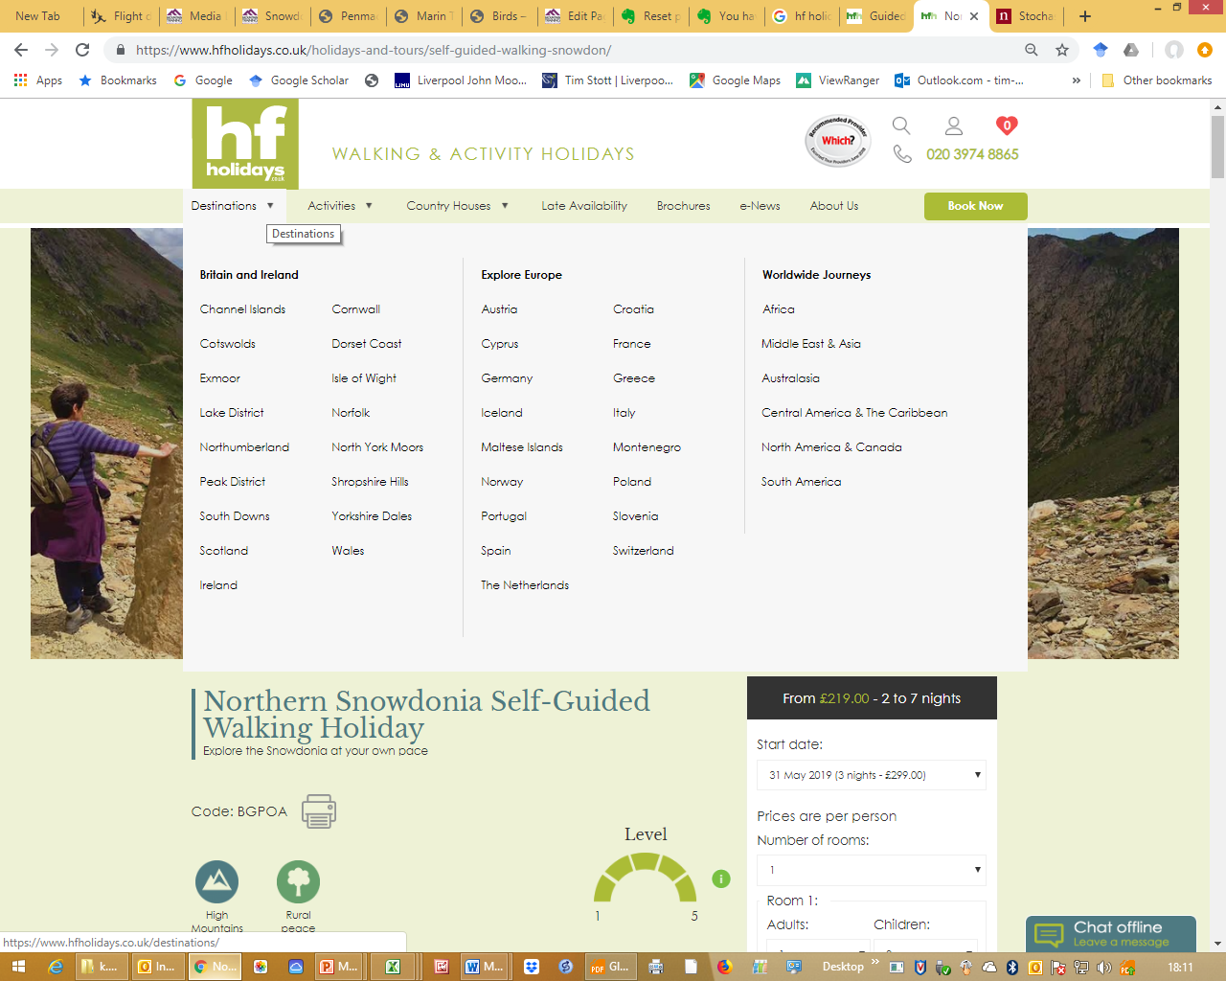

Slide 24
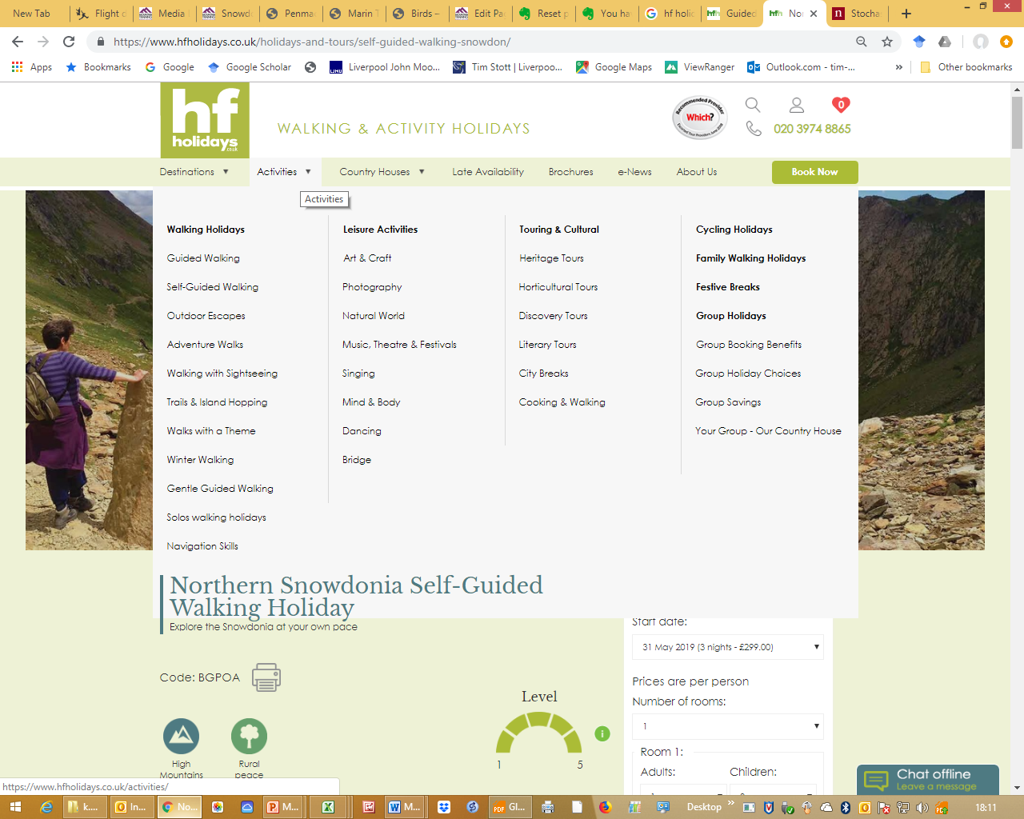

Slide 25
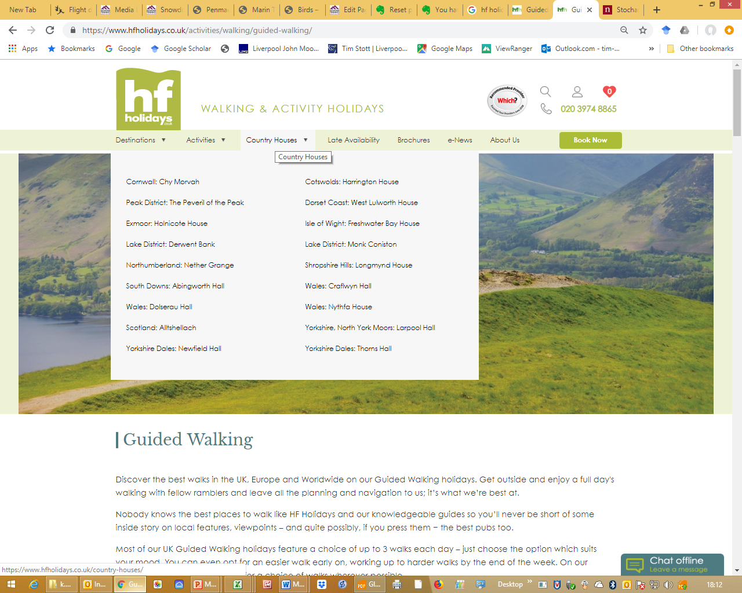

Slide 26
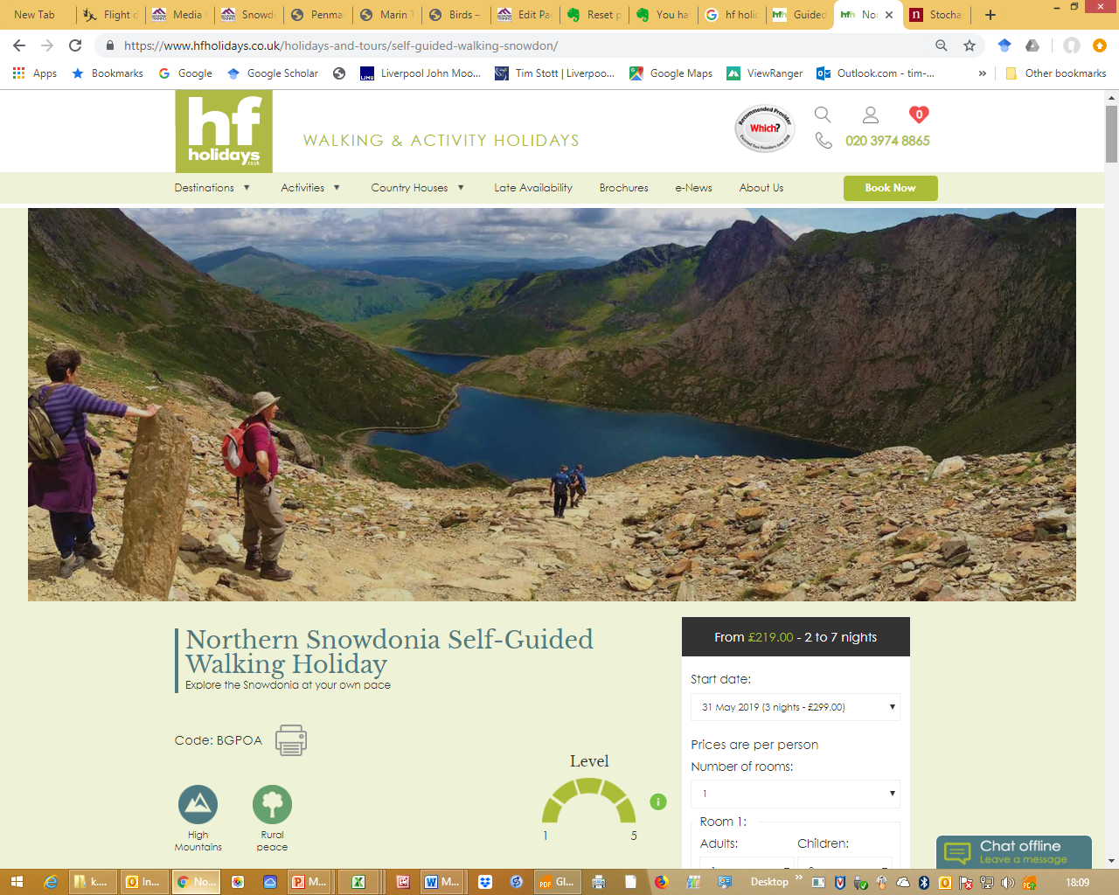

Slide 27
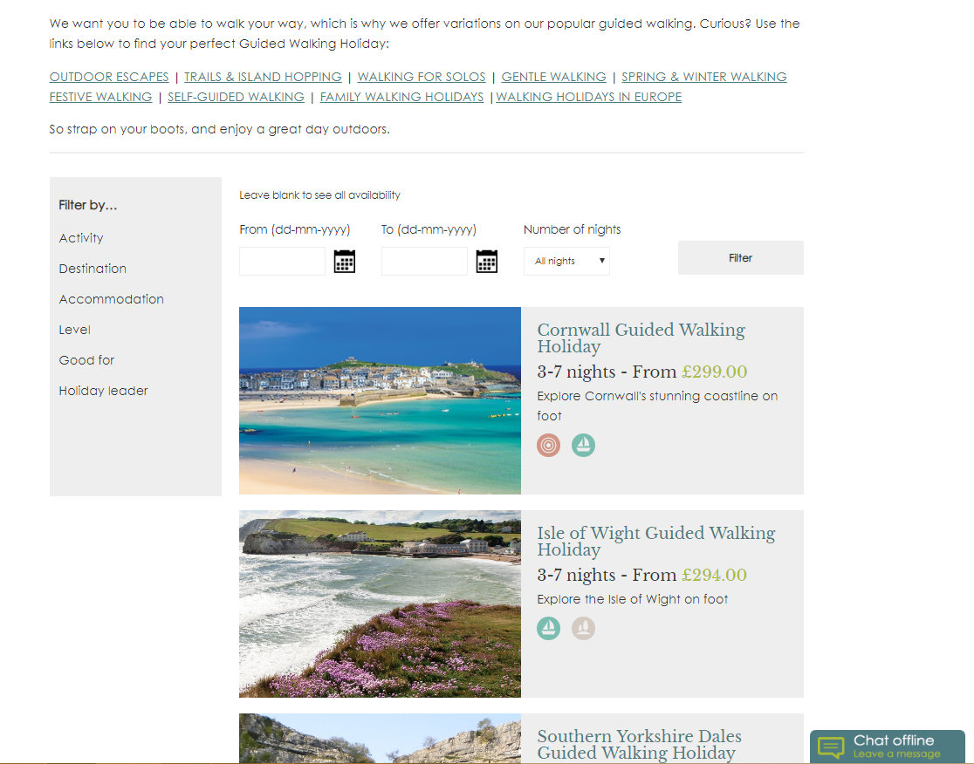
Variations in Guided Walking

Slide 28
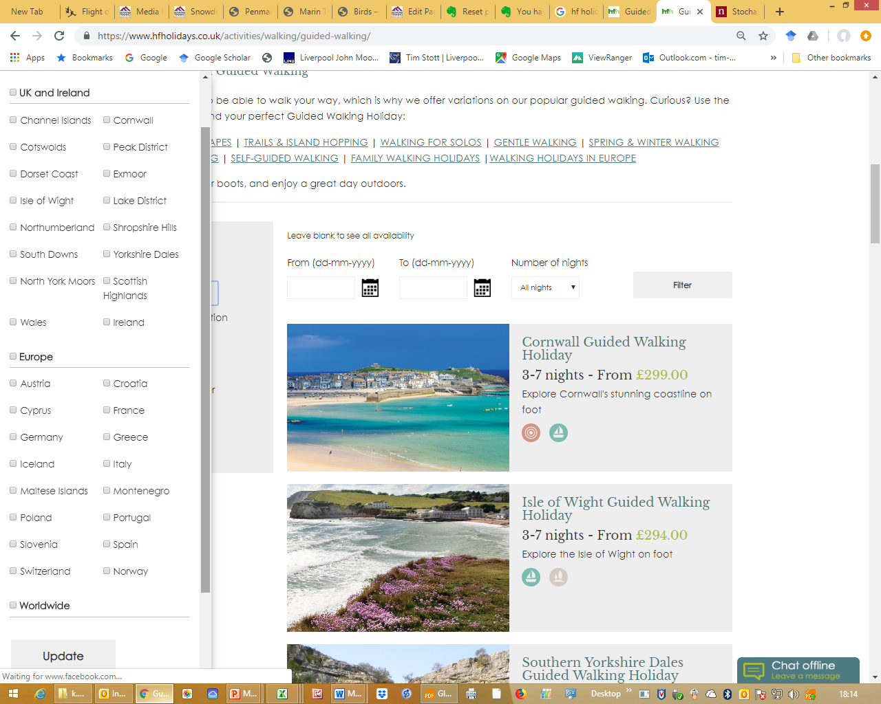
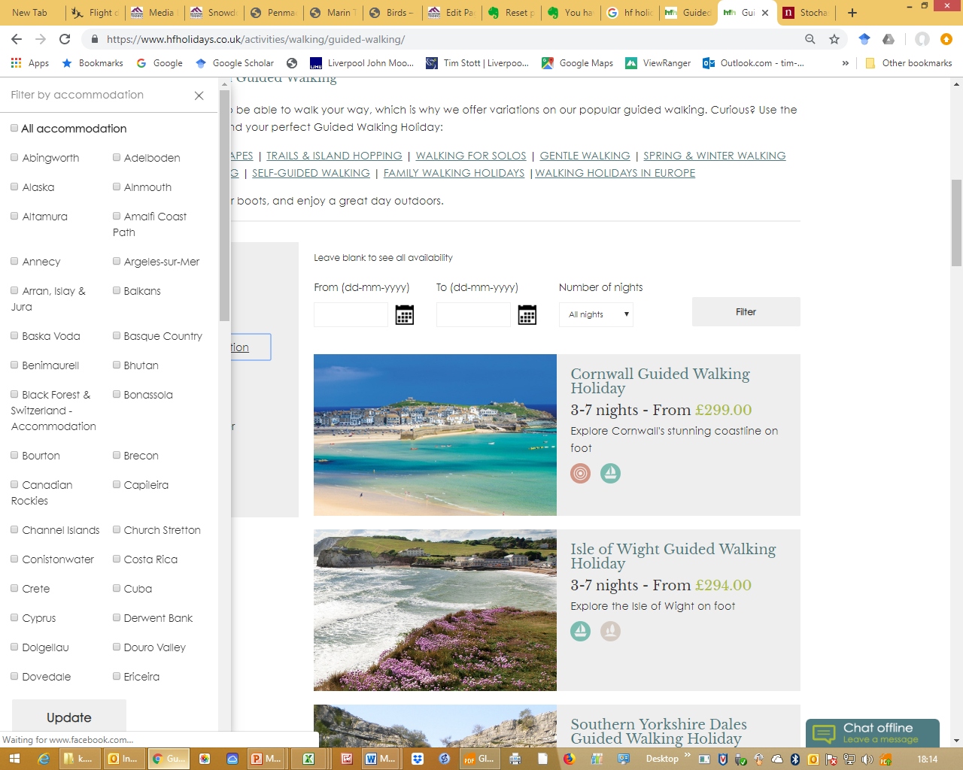
Sophisticated web site
250 – 300 holidays

Slide 29
Exciting? Adventurous? Some issues.
Ben Nevis
Sca Fell
Corsica
Medical Forms? Self declaration…??
Big Responsibility
No sat phone?
No pay?

Slide 30
The role of outdoor education in walking promotion
Duke of Edinburgh’s Award (Expeditions)
World Challenge
British Exploring Society
Outdoor Education Centres
Colleges/Universities
BSc (Hons) Outdoor Education
Basic Expedition Leader’s Award (BELA)
Hill & Moorland Leader (600m)
Mountain Leader (summer), MLS
Mountain Leader (Winter), MLW
International Mountain Leader (IML)
MIA/MIC; IFMGA Mountain Guide
Can good quality leaders make a difference ? Motivation, sustainability, wider interests ?

Slide 31
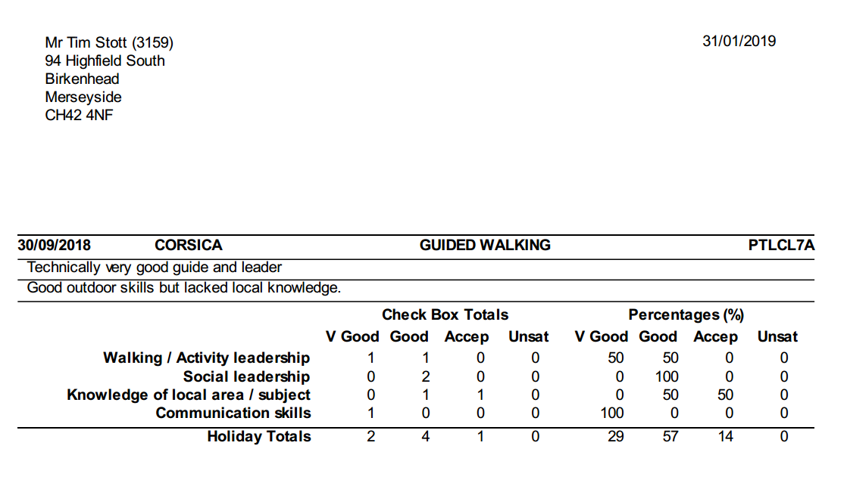
HF Leader Evaluation (every week) by guests
In Outdoor Education: debrief, review, evaluation, what next?
That’s standard or normal……professional vs recreational?

Slide 32
What are my main feelings/reasons for walking/mountaineering/ski touring ?
Reward (reach a summit; complete lists; physical fatigue, burn, euphoria)
“slow adventure” (Varley & Semple, 2015)
Physical fitness/training for more/bigger/further – distant objectives/targets
“Professional profile”
Personal ambition
Push limits – in past, but not so much now
Escape/recreate – work/life balance, manages stress
Professional development
Varley, P., & Semple, T. (2015). Nordic slow adventure: Explorations in time and nature.
Scandinavian Journal of Hospitality and Tourism, 15(1-2), 73-90.

Slide 33
Which could be transferable to others/active transport maybe ?
Reward (reach a summit; complete lists; physical fatigue, burn, euphoria) – SAVE MONEY
“slow adventure” (Varley & Semple, 2015)
Physical fitness/training for more/bigger/further – distant objectives/targets. TRAIN FOR AN EVENT/HOLIDAY
“Professional profile” (Boris?)
Personal ambition??
Push limits?? – in past, but not so much now RACE TO WORK?
Escape/recreate – work/life balance, manages stress YES
Professional development??
Varley, P., & Semple, T. (2015). Nordic slow adventure: Explorations in time and nature.
Scandinavian Journal of Hospitality and Tourism, 15(1-2), 73-90.

Slide 34
Teaching the next generation of outdoor educators
What do we teach to outdoor education students to ensure that they will encourage recreational walking in the wider community?
Mountain Leader Training (1st year, 20 QMDs), Assessment (3rd year, 40 QMDs) ESSENTIAL TO WORK (navigation, hill-craft, emergencies/16h outdoor first aid, river crossing, steep ground (rope), campcraft, environmental impact/conservation)
Geology, Ecology, Landscape interpretation, archaeology, weather/climate, climate change, rivers, glaciation, environmental issues (sanitation, litter etc.)

Slide 36
Why are outdoor educators essential for improving walking engagement?
“soft skills” vs “hard skills”
Mental Health First Aid
A well led/cohesive group (team) is less likely to get into difficulties
Broad knowledge gained from experience (can converse on a wide range on topics). Can point out things of interest to distract from the physical pain!!
Experience, experience, experience!! No substitute??

Slide 38
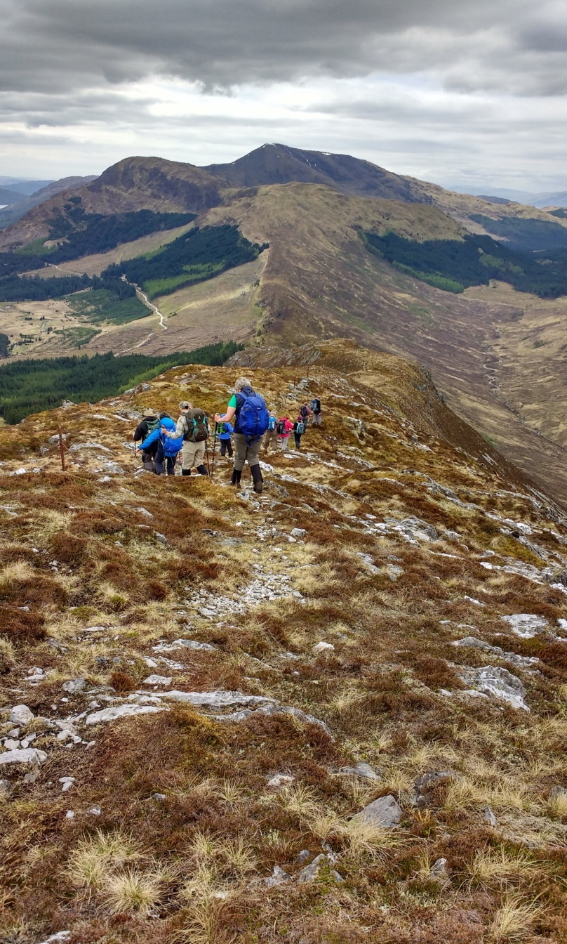
Questions and suggestions?
Contact details:
N.Morocza@2016.ljmu.ac.uk
T.A.Stott@ljmu.ac.uk

