Slide 1

Walking in Greater Manchester
Carragh Teague
Sustainable Journeys
Transport for Greater Manchester
May 2019
Notes:
1
Good afternoon, my name is Carragh Teague & I work for Transport for Greater Manchester in the Sustainable Journeys Team

Slide 2
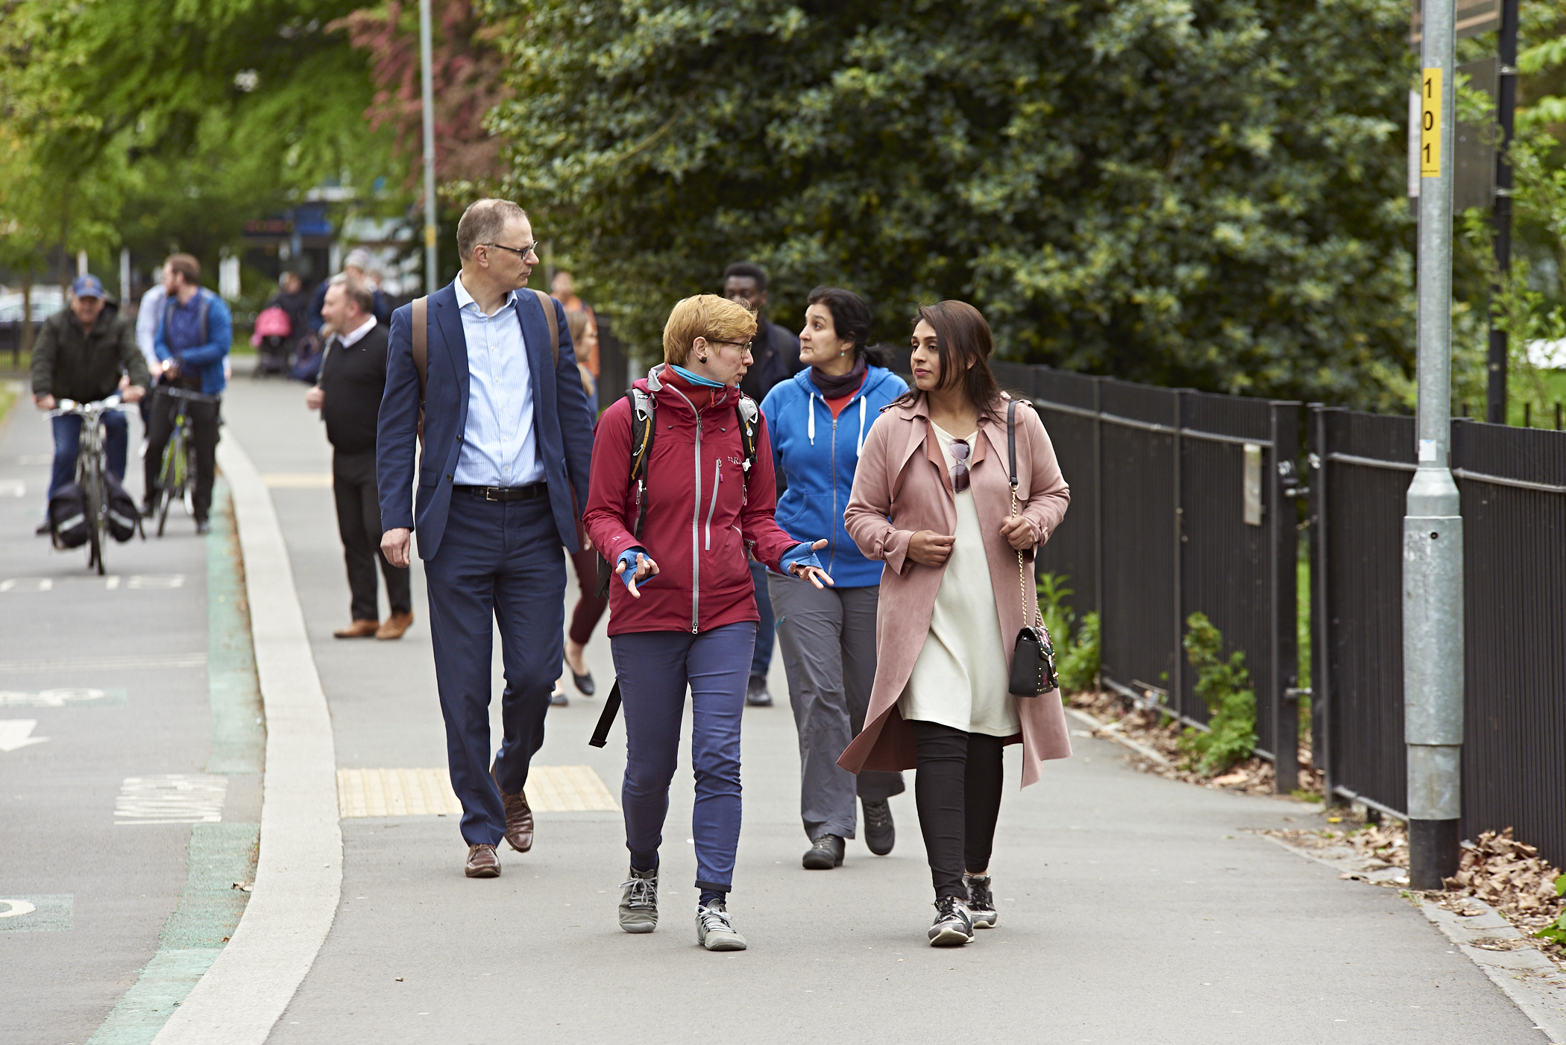
Content
1. What do we know about walking in GM?
2. Recreational to everyday walking?
Notes:
For todays presentation I going to firstly talk about the current data we have for utility walking in GM, and the further research TfGM’s insight team have been carrying out. Data is so important to everything we do especially with regarding to Active Travel.
For the transport buffs in the room or if you are some one who has been to NYC in the last couple of years your are probably aware of the City's transformation into a pedestrian haven in recent years. The person behind this is Janette Sadik-Khan, she was the city's Department of Transportation Commissioner between 2007 and 2013.
During Sadik-Khan's time, the city built 60 pedestrian plazas (including the Times Square plaza that's closed off to cars for five blocks), nearly 400 miles of bike lanes (including the city's first protected lanes),
It wasn't easy. One of the ways that Sadik-Khan was able to overcome potential bureaucratic gridlock: data. Lots of it. One of her famous quotes is: "In God we trust. Everyone else bring data."
For the second part of the presentation Im going to briefly talk about current research or the lack of research demonstrating the link between recreational walking and everyday walking.

Slide 3

Walking in GM evidence review
Situation
Main mode for around a quarter of GM (1)
Approx. 569 million trips a year (1)
Main purpose is shopping (25%) (1)
Average walking distance is 0.66km; and 0.96km for those commuting (1)
10% walk to work (main mode) (1)
2001 - 2011 Census shows 14% growth in walking to work (106k – 121k)
63% walk ‘all the way’, at least once a week; mainly for social and shopping purposes (2)
13% net increase in walking, compared to one year ago (2)
Fitness is key reason why they walk more (2)
TRADS
Segmentation
Congestion Conversation
Question
How do we motivate people to walk past their car?
How do we influence attitude, relevance and acquisition (in an Easy, Attractive, Social and Timely way)?
Complication
30% of journeys under 1km are made by car (1)
40% consider pedestrians to have too little consideration in road space allocation (3)
Dearth of data
Attitudinal knowledge gap – understanding why
Necessity of multiple trip chaining requirements
Data may under-represent walking
(Some) answers
New Sales Funnel & Network Principles research, 2016-17 Active Lives, Segmentation Tool application, forthcoming Neighbourhood and MCF/Made to Move Research
Notes:
1.6 Walking is by far the greatest activity undertaken in England with 18.6 million people doing at least two sessions of walking for Leisure and 14.5 million people doing at least two sessions of walking for transport.
So what do we know about walking in GM?
Walking is the main mode of transport for around a quarter of trips made in GM.
The main purpose of these trips is for shopping.
For those trips being done to get to work the average distance is under 1km.
On a positive note The 2001-2011 census shows there's been a 14% growth in walking to work
And there has been a 13% net increase in walking compared to one year
With fitness being identified as the key motivation as to why people are walking more.
Now for the negatives:
As Jenny mentioned earlier 30% of journeys under 1km are being made by car in GM
40% of people consider pedestrians to have too little consideration in road space allocation
One of the complications is the diverse and very local nature of trips and routes when it comes to walking – it’s far harder to cater for, or prioritise, such a variety of short dispersed trips in infrastructure terms than it is to cater for a large volume of long distance trips which can be funnelled onto a key route.
We have a lack of data compared to other modes of transport in understanding the whys? and the data we do have may still be under-representing walking
And so the questions we need to address are how do we motivate people to walk past their car? How can we influence their choices and attitudes? And what additional research can we do and are doing?
3

Slide 4

Sales Funnel
Cycling and walking extract
Notes:
In February 2018, Ipsos MORI were commissioned by Transport for Greater Manchester (TfGM) to create a baseline measure of where Greater Manchester residents sit within a ‘sales funnel’ model, incorporating aspects such as their attitude, relevance, experience and advocacy towards different modes of public transport, as well as active travel.
The ‘sales funnel’ approach is primarily a model of consumer behaviour that helps to drive sales by directing efforts towards the stages of decision-making that need most attention; however, TfGM believe that people’s decision-making about which modes of transport they use can also be understood using this framework. Knowing the proportion of residents at each stage will facilitate the future tracking of success towards people using more sustainable methods of travel.
The overall objectives of the research were to:
▪ Measure, as a baseline indicator of progress, the proportions of Greater Manchester residents who can be identified as occupying each of the five stages of a ‘sales funnel’ or decision-making journey;
▪ Understand how residents arrive at their respective positions, and what causes them to progress or regress through the funnel.

Slide 5

Customers drop out at different points, but can also re-enter at any time. This is not a fixed process. Arguably the reality of consumer decision making is a far more circular journey
Oblivious*
Rejecters
Not nows
Customer journey
Dabblers
Habituals
Champions
* Everyone is aware of public transport, cycling and walking. Only relevant for EVs
TfGM Sales Funnel | Fieldwork 30 July 2018 –22 October 2018 |
Notes:
For this piece of research the assumption is that all consumers are possible customers. However not everyone is aware of what is available to them. Some may not have a good impression of the product, whereas for some it simply may not be fit for their needs. There are various reasons why all consumers don’t become customers. There are equally numerous reasons why someone becomes a customer and why they may remain so. And just because they’re customers doesn’t mean they’re satisfied…
Understanding this customer journey has been compared to a leaky pipe. Imagine the whole GM population entering the pipe, and all those who reach the tap are the most satisfied and product advocates.
Consumers leak out of the pipe at various points depending on their product awareness, inclination, relevance, use, experience and ultimate advocacy…

Slide 6
How often do they walk?
Walking
AT LEAST ONCE A WEEK
NOT IN LAST 12 MONTHS
LESS THAN ONCE A WEEK BUT AT LEAST ONCE IN LAST 12 MONTHS
Would they recommend?
How positive or negative about walking?
8-10
SCORE
0-7 SCORE
POSITIVE/NEUTRAL
NEGATIVE
Champions
Habituals
Dabblers
Not nows
Rejecters
TfGM Sales Funnel | Fieldwork 30 July 2018 –22 October 2018 |
Notes:
People were asked a series of questions for each mode. For walking they were asked:
How often did they walk, and by that we mean if they walk somewhere i.e travelling from one place to another, not just going for a walk.
If they did, would they recommend walking, if they didn’t walk how positive or negative were they about walking.
They would then fall into the different categories: Champions, Habituals, Dabblers (less than once a week but atleast once in the last 12 months), not nows and rejectors.

Slide 7
How often do they walk?
Walking
AT LEAST ONCE A WEEK
NOT IN LAST 12 MONTHS
LESS THAN ONCE A WEEK BUT AT LEAST ONCE IN LAST 12 MONTHS
Would they recommend?
How positive or negative about walk?
8-10
SCORE
0-7 SCORE
POSITIVE/
NEUTRAL
NEGATIVE
53%
22%
11%
10%
4%
TfGM Sales Funnel | Fieldwork 30 July 2018 –22 October 2018 | Base 4318 (weighted)
Notes:
53% of participants said they walked at least once a week and would recommend it
22% said they walked at least once a week
11% said that they had walked at least once in the last 12 months
10% said they hadn’t but understood the reasons why they could or should
4% said they hadn’t and didn’t want to or had reasons why they wouldn’t be doing

Slide 8
Sales funnel all mode summary
TfGM Sales Funnel | Fieldwork 30 July 2018 –22 October 2018 |
Notes:
When we compare the walking figures with other sustainable modes its great to see that walking is leading the way. We have the highest number of champions and usual's groups and the lowest ‘not now’ group..
Which leads me to finish with a couple of questions for you all and something to think about in the later sessions.
How do we convert the dabblers and usuals to move up the stages to walking champions and furthermore how do we utilise and engage with the current walking champions to shout louder about walking in Greater Manchester and help us create a culture of walking as the norm for short journeys.

Slide 9
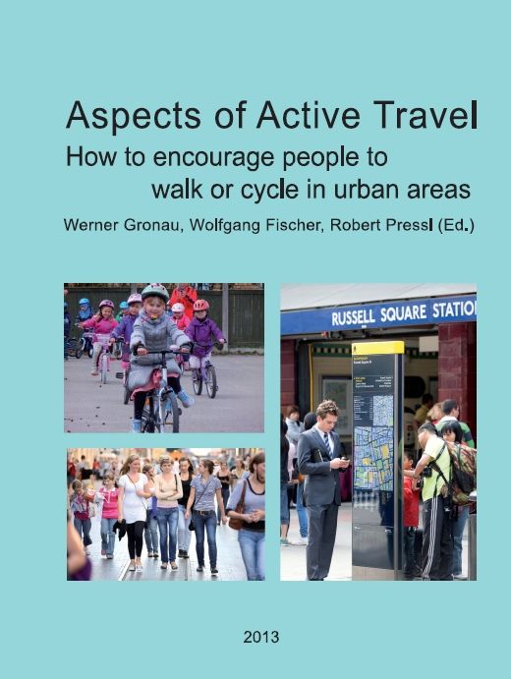
Research
Notes:
Current research…
1. Launched in 2013 Make Walking Count is a survey, analysis and reporting framework, designed by Walk21 to explore residents’ attitudes toward walking generally and their walking behaviour in their own neighbourhood in particular. Make Walking Count is also an international benchmarking tool to provide information to cities to help them steer their policies and investments in walking and to enable learning between cities and communities.
Initially undertaken in four world cities, the tool is now being used successfully in communities of various sizes, to understand and benchmark the needs of local people and to ensure a user perspective to inform decision making and to identify the best spend for investments in walking infrastructure, information and encouragement programmes.
More background information and some first results can be found in this article by Bronwen Thornton, Martin Wedderburn and Daniel Sauter, published in “Aspects of Active Travel. How to encourage people to walk or cycle in urban areas”
Interesting in the article it reports that cities which reported of high ‘Unitarian walking or everyday walking e.g. London and Barcelona also report of having the lowest levels of recreational walking or ‘just going for a walk for pleasure’
Another piece of research which I thought was really relevant for todays discussion is Sport England's new Active Travel and Physical Activity Evidence Review.
The new research provides an authoritative account of how, and how best, active travel can support physical activity.
Carried out by an independent team led by Sustrans, in partnership with Dr Nick Cavill and Prof Adrian Davis, it assesses the current and potential contribution of active travel to overall physical activity levels and reviews the effectiveness of many types of active travel interventions at increasing walking, cycling or physical activity.
Interestingly in the summary it mentions how the report can be used to help deliver active travel by building the strongest case, strengthen your rationale for investing in active travel but also strengthens the case for more research needed to understand the link between active travel and physical activity.

Slide 10

Which way?

Slide 11
Thank you
Carragh.Teague@tfgm.com
Thank you for listening www.tfgm.com/walking
Notes:
Thank you

