Slide 1
Sustainable Transport Futures at the University of Salford
Seminar 4: Forgotten Transport – How can we make everyday walking more fun? 30/05/19

Slide 2
Sustainable Transport Futures at Salford
Smart Travel - Can big data save our cities?
Thursday 27th June (12:30-2pm)
Work in progress
2nd October (12:30-2pm)

Slide 3
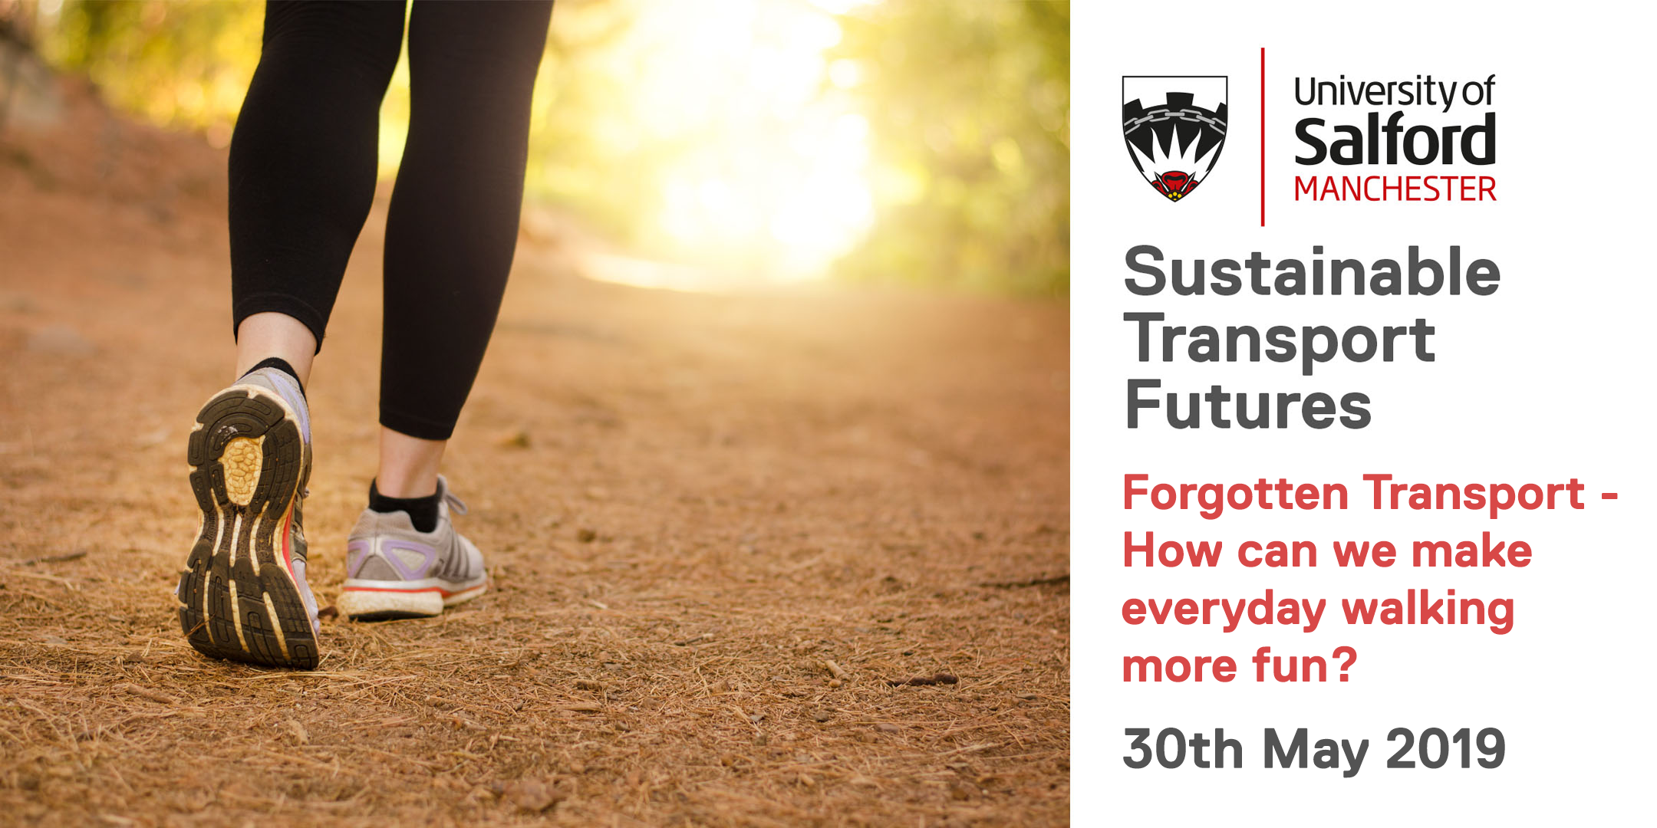
bit.ly/healthyactivecities

Slide 4
AGENDA
Intro to seminar and series Carragh Teague
Walking Coordinator, Transport for Greater Manchester
Louise Robbins
Walking Programme Lead, GM Moving
Prof Tim Stott
Professor in Physical Geography and Outdoor Education,
Liverpool John Moores University
Nora Morocza
PhD Researcher, Liverpool John Moores University
Jenny Wiles
Regional Director (North) – Living Streets
Questions and Discussion
Finish

Slide 5
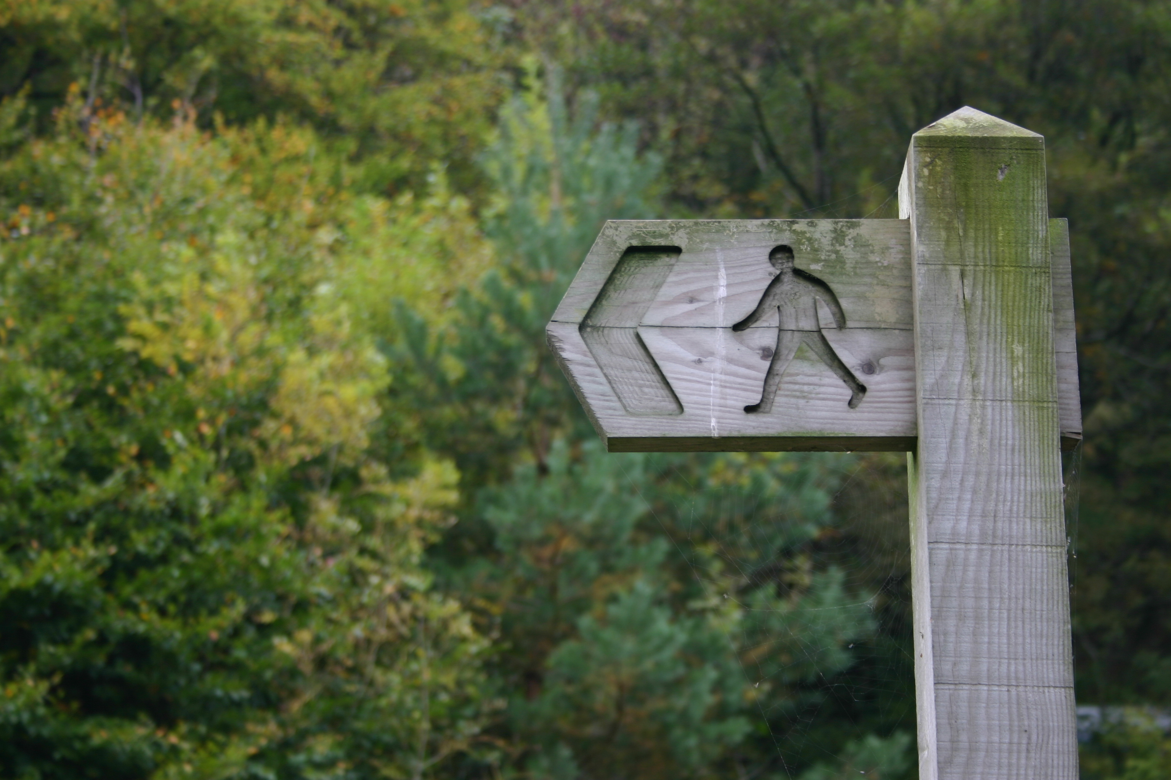
Q & A

Slide 6
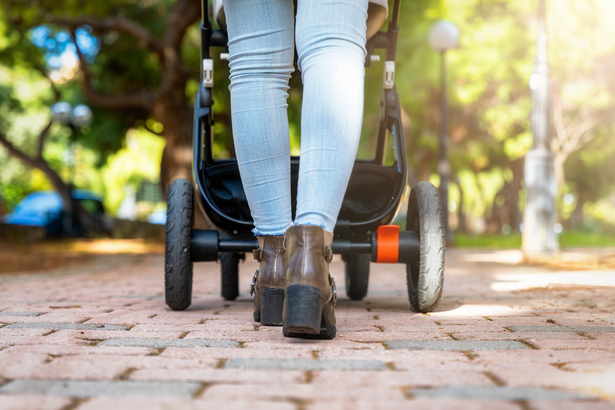
FINAL REMARKS

