Slide 1


Greater Manchester: A Walking Region
The Greater Manchester Moving Walking Programme
Louise Robbins
GM Moving Walking Programme Lead
30th May 2019
Notes:
£2m investment into Sport and Physical Activity at a Greater Manchester level, which aligns with GM Moving Priorities and is transformational in its approach

Slide 2
Greater Manchester: A Walking Region
‘aims to empower a movement through the creation of a walking culture on a scale not seen anywhere else, where walking becomes a normal part of everyday life’
‘where walking becomes a cultural norm and the first choice for travel’
Notes:
We have a collective ambition with partners

Slide 3
The GM Walking programme supports:
GM Moving Strategy: vision for investing in physical activity to realise the ambition of getting 75% of the population to be active or fairly active by 2025.
Made to Move: make walking and cycling the natural choice for short journeys by investing in infrastructure.
Greater Manchester Health & Social Care Partnership: developed their Population Health Plan - key theme increasing physical activity levels using whole system approaches.
Notes:
£2m investment into Sport and Physical Activity at a Greater Manchester level, which aligns with GM Moving Priorities and is transformational in its approach

Slide 4
What do we mean by walking?
Walking for leisure in a formal walking group, as an individual or informally with a friend(s)
Build walking into everyday routines such as a lunchtime walk at work or a ‘daily mile’
Functional walking, such as when going shopping
Active travel – walking to get from A to B i.e. walking to work or school.

Slide 5
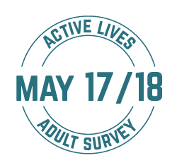

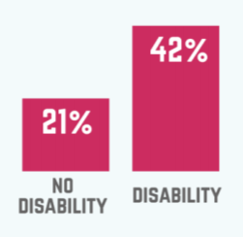
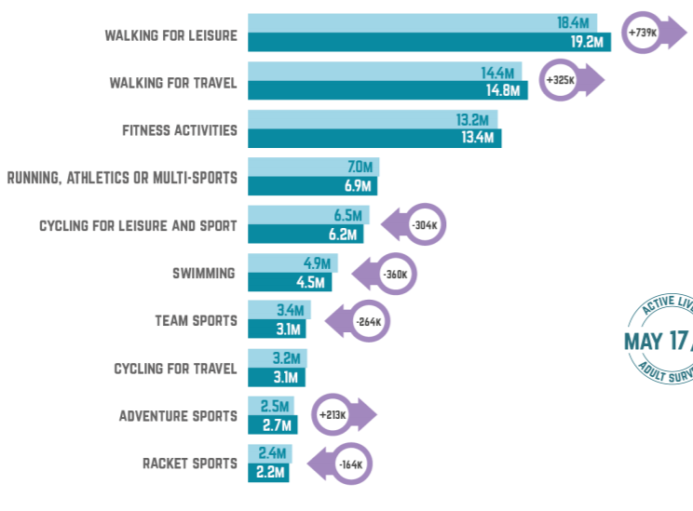
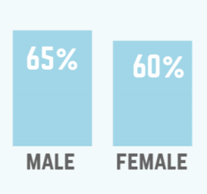
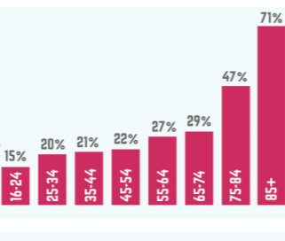
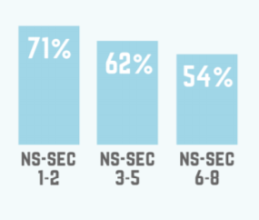
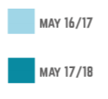
Active Lives Data shows…
Disability
Gender
Social Economic Groups
Age
Notes:
National Data…

Slide 6
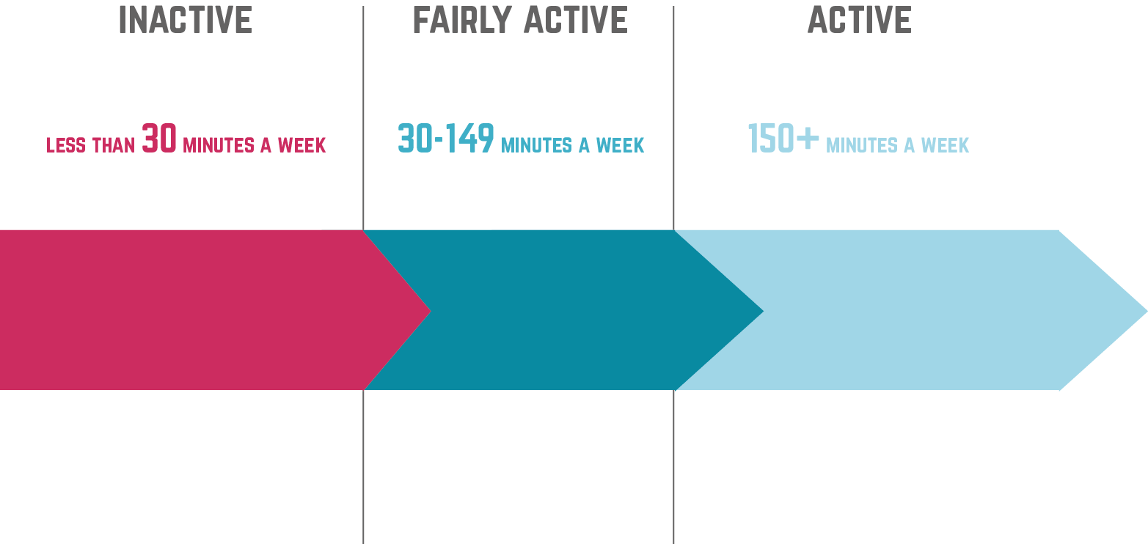
levels of activity
…and in Greater Manchester
27.1%
12.3%
60.6%
600k did less than 30 minutes a week
270k were fairly active but didn’t reach150 minutes a week
1.35m did 150 minutes
or more a week
Notes:
Because in GM

Slide 7
The GM Moving Walking Programme
Supporting GM Moving , GMCA and Population Health strategic aims
A focus on inactive populations – across the lifecourse
Engagement, person centred
Community led informal and formal walking opportunities and mass walking events
Resources
Website digital
Walking Campaign
A Voice for Walking
The Daily Mile
Champions
Enablers – workforce training, evaluation, insight, marketing & communications
Notes:
Using transformational change principles
Person and community centred
Test and learn
Community led informal walking opportunities and walking events including the GM Walking Festival
Most people agree that
Walking can help connect people with environment, their community and each other
Health and social benefits
Economic and environmental benefits

Slide 8

The GM Walking Ambition
10GM and voluntary, community & social enterprise groups
NHS partners
GM Active
The Ramblers
Living Streets
TfGM
Sustrans
Localities
info@gmmoving.co.uk
Notes:
Connect to Chris Boardman’s Made to Move through TfGM and the GM Alliance
organisations or social enterprises, community groups delivering walking or with an interest in walking
Missing - workplaces
Work with GM Alliance
Work alongside WalkRide GM
,

Slide 9
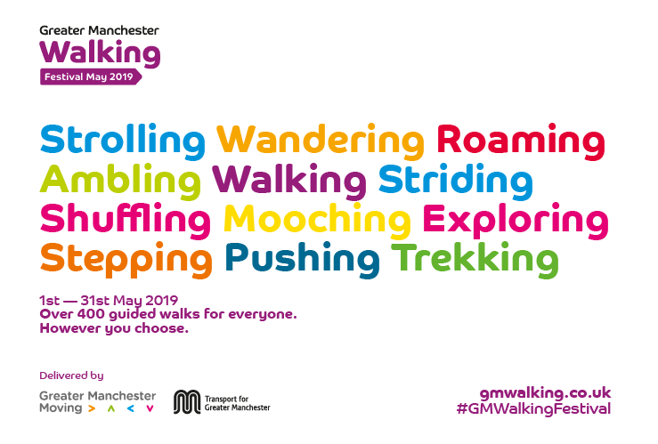

Slide 10
Get Involved - Contact us
Greater Manchester Moving Walking Programme
Louise Robbins
07740 883080
info@gmmoving.co.uk
@GMMoving #GMWalking
Sign up for the GM Walking Voice Network to hear more about our work

