Slide 1
WWW.LIVINGstreets.org.uk
Notes:
I’m Jenny Wiles – Regional Director for the North of England at Living Streets, the UK charity for everyday walking.
We want to create a nation where walking is the natural choice for everyday, local journeys; free from congested roads and pollution, reducing the risk of preventable illnesses and social isolation. We want to achieve a better walking environment and to inspire people of all generations to enjoy the benefits the simple act of walking brings.
This year we celebrate our 90th birthday! It’s also National Walking Month during May (alongside GM Walking Festival).

Slide 2
DOES IT SPARK JOY?
Notes:
Marie Kondo, the queen of tidying up, encourages us to ask, ‘does it spark joy?’ for each item we own. What if we did the same for our local streets and the experience of walking in them? Hands up if your local streets spark joy! So what can we do to add a bit of joy into everyday walking?

Slide 3
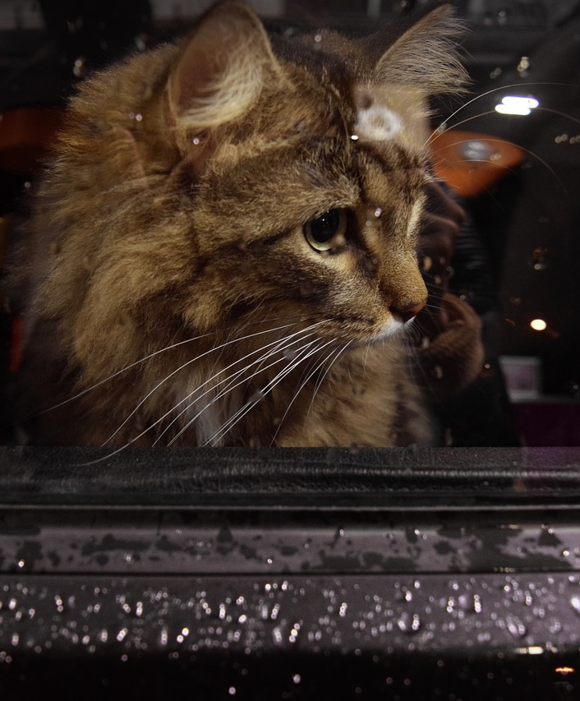
Walking needs to look: safe easy fun
Notes:
Chris Boardman talks about wanting someone to look out of car window and say, ‘hmm that looks like something I might want to do’ – safe, easy, enjoyable

Slide 4
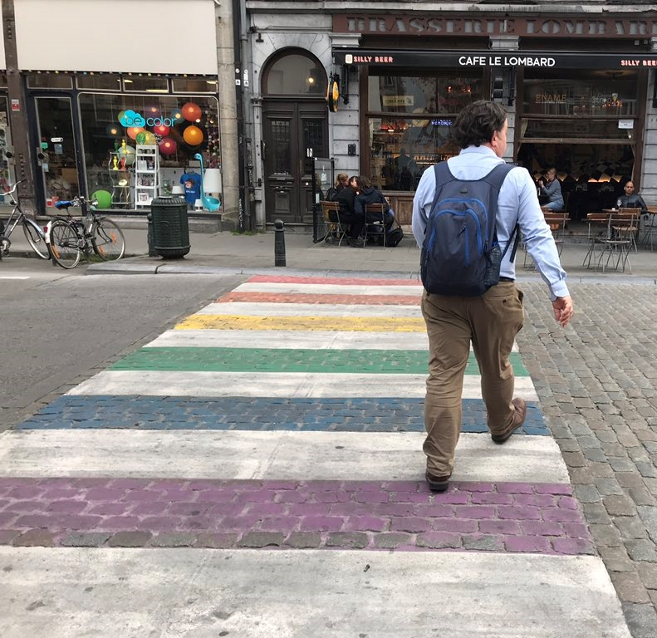
STREEts that spark joy
Notes:
Miffy crossing in Utrecht
Chris Martin tweeted “Takeaway feeling from #Brussels. Design a city that is inclusive, enjoyable, and fun - and you’ll get a great place to walk. @bricycle showing us how it’s done. @UM_Streets”

Slide 5
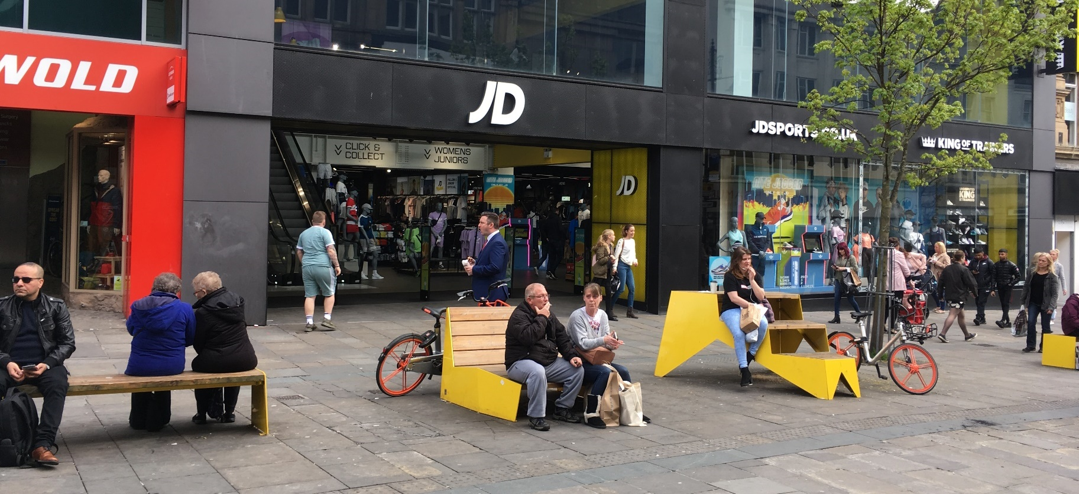
Notes:
Seating - Newcastle
Street Art – Manchester NQ
Another Chris Martin pic from Brussells

Slide 6
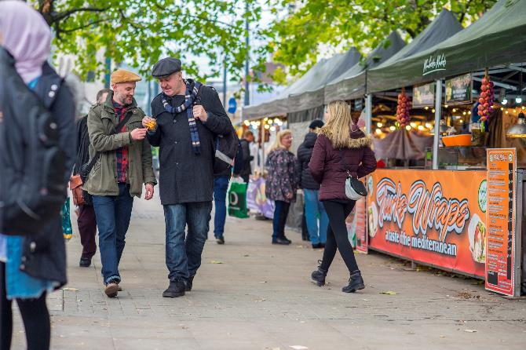
STREEt animation
Notes:
Temporary installations and events
Manchester markets
Bristol water slide
Lumiere Durham

Slide 7
PARKLETs
Summer streets
Notes:
Made to Move step 15 – launch summer streets festival, to trial street closures
Helping communities to envisage a low car future and the benefits this brings
Trying things out that could then be made permanent
Parklet in Hackney
Summer Streets on Regent Street in London

Slide 8
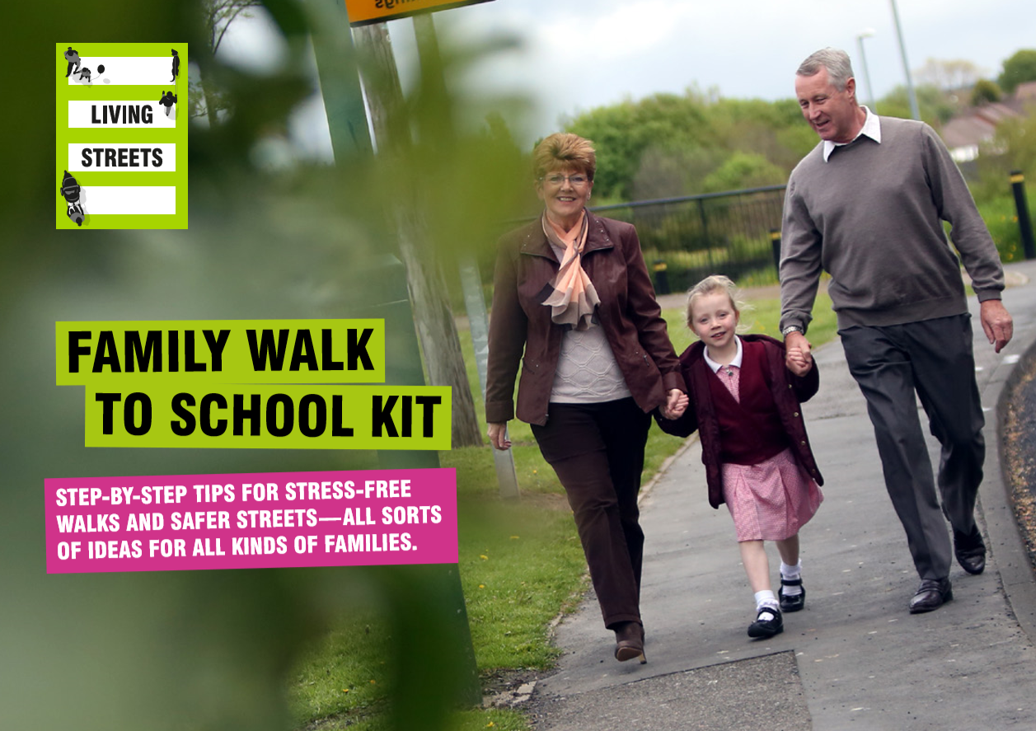
Notes:
Walking with children/ our inner child - lighting the spark
Also, I think that the simple kid's games stuff can be useful. Get people to look for certain flowers/trees en route, or allocate coloured cars, or look for local landmarks - first one to see gets a surprise!. Doing silly walks or counting steps in Scout's pace (20 steps walk, 20 fast walk, 20 run or try to). at Christmas lights time, count Santa/reindeer, trees in windows.
Family Walk to School kit

Slide 9
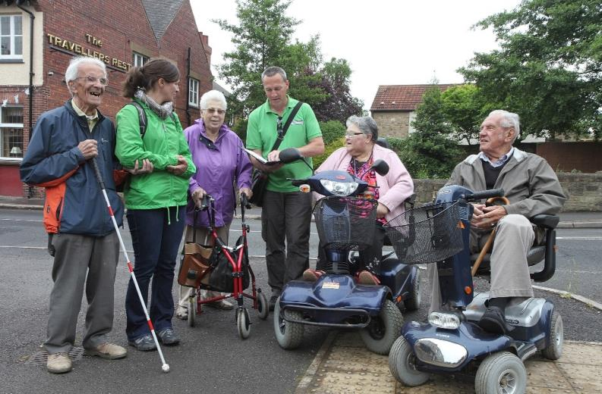
Notes:
Communities/Older people – rediscovering the spark
Not ‘going on a walk’ – health by stealth, walking not the main focus
Jim - With one of my older people's groups we always walked to the same destination - a local café ! To make this more interesting, each week we tried to incorporate a 'hidden gem' element to the walk - so taking in the Peace Gardens, Market Cross, local Church and Cenataph on different occasions - some walkers had never seen some of these, despite living in the area for many years. With a disability group I had we also walked to the same venue every week. With this group we mapped different routes beforehand, and used pedometers to see how many different routes/streets we could take to get to the same place and how many steps each route was. I dare say you could use elements of an audit walk too and ask walkers to highlight what they like and don't like about the route - what they would change and what would help accessibility. or help overcome certain barriers. Sometimes this is a good exercise in its own right and makes people look at familiar areas with fresh eyes and perspectives, even if there is no promise of any ensuing action.

Slide 10
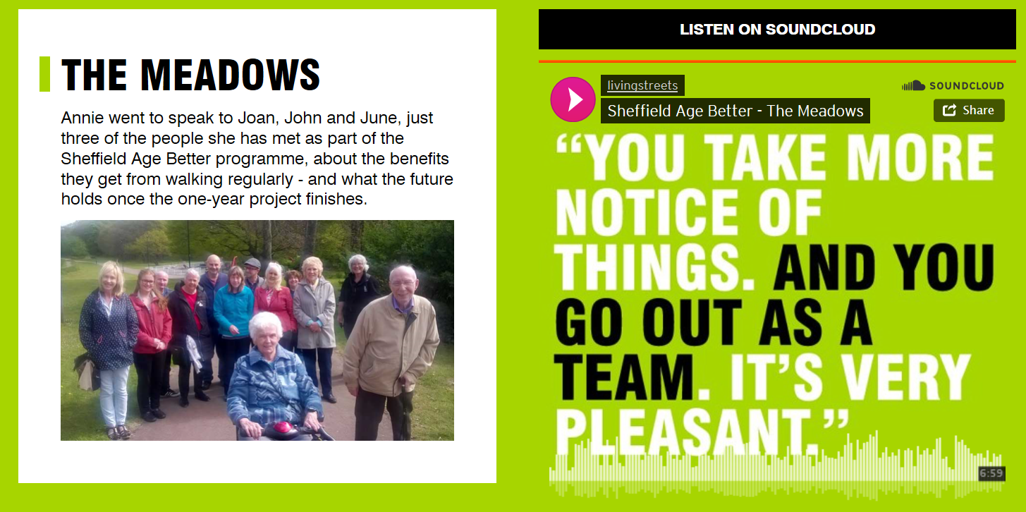
AGE BETTEr in Sheffield
Notes:
Social aspect of walking together was key to making it fun for these older people

Slide 11
Thank you
www.livingstreets.org.uk
Jenny Wiles - Regional Director (North)
Email: jennifer.wiles@livingstreets.org.uk
Tel: 07702 717540

